Slide 1


Chapter 7 Part IV: Working with MongoDB
Instructor: He Li

Slide 2
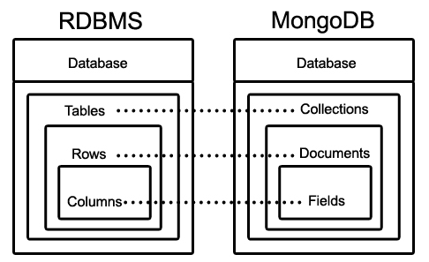
Introduction to MongoDB
Supporting large data sets; designed for high availability, scalability, and performance.
Widely adopted in companies such as Adobe, Nokia, eBay, SAP, Cisco, Verizon, etc.
Schema-less and aggregate aware
Documents are formatted using BSON for storage and appear as JSON files for users
Notes:
MongoDB is designed with the objective of supporting extremely large data sets. It is designed for high availability, scalability, and performance. MongoDB is a very successful NoSQL product and has attracted huge attentions from companies. Many big companies are using it, including Adobe, Nokia, eBay, SAP, Cisco, Verizon, etc.
As a document database, MongoDB is schema-less and aggregate aware. Being schema-less means that all documents are not required to conform to the same structure, and the structure of documents does not have to be declared ahead of time. Aggregate aware means that the documents encapsulate all relevant data related to a central entity within the same document.
As shown in this figure, data is stored in documents, documents of a similar type are stored in collections, and related collections are stored in a database. Field is a key-value pair in a document. A document has zero or more fields. Fields are like columns in relational databases. It is very important to understand this MongoDB structure and key terminologies.
Documents are formatted using BSON for storage, which is a lightweight, binary representation of JSON, but with support for added features like a greater range of data types. To the users, the documents appear as JSON files, which makes them easy to read and easy to manipulate in a variety of programming languages. Understanding the basic structure of a JSON document is essential for working with MongoDB.

Slide 3
JSON Documents
JavaScript Object Notation (JSON) is a data interchange format that represents data as a logical object.
Key-value pairs are typically written in the format key:value
A simple example:
{_id: 101, title: “Database Systems”}
Adding a key:value pair with multiple values:
{_id: 101, title: “Database Systems”, author: [“Coronel”, “Morris”]}
Improve readability:
{
_id: 101,
title: “Database Systems”,
author: [“Coronel”, “Morris”]
}
Notes:
JavaScript Object Notation (JSON) is a data interchange format that represents data as a logical object. Look at this simple example. Objects are enclosed in curly brackets {} that contain key-value pairs. When discussing JSON documents, the key-value pairs are typically written in the format key:value. This simple example contains two key-value pairs: _id is a key with 101 as the associated value; title is a key with “Database Systems” as the associated value. A single JSON object can contain many key:value pairs separated by commas.
In different circumstances, you may see the terminology key:value, tag:value, field:value, id:value, or property:value used, but they all mean the same thing, so do not allow these changes in terminology to throw you off.
The value component may have multiple values that would be appropriate for a given key. In this example, adding a key:value pair for authors could have the values “Coronel” and “Morris.” When there are multiple values for a single key, an array is used. Arrays in JSON are placed inside square brackets []. For example, the above document could be expanded like this…
When JSON documents are intended to be read by humans, they are often displayed with each key:value pair on a separate line to improve readability, like this ….

Slide 4
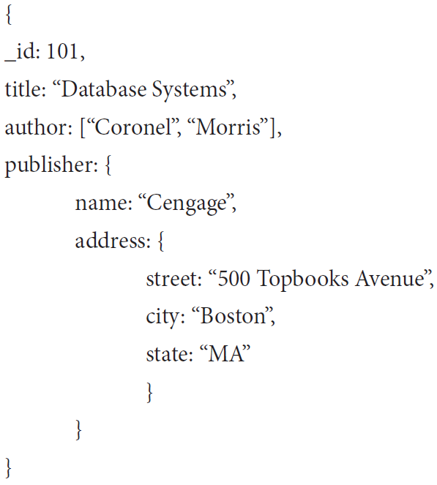
JSON Documents (cont.)
{
Name: “Cengage”,
Address: “500 Topbooks Avenue”,
City: “Boston”,
State: “MA”
}
{
_id: 101,
title: “Database Systems”,
author: [“Coronel”, “Morris”],
publisher: {
name: “Cengage”,
street: “500 Topbooks Avenue”,
city: “Boston”,
state: “MA”
}
}
Notes:
Objects can also have other objects embedded as a value. When a JSON document has an embedded object, the embedded object is often referred to as a subdocument. Consider another simple document with data about a publisher that is related to the book in the previous example.
The book document and the publisher document are related. Remember, document databases are aggregate aware, so documents are typically arranged around a central entity. If we are constructing documents that have a book as the central entity, then we may wish to include data about the publisher inside that document. To include the publisher information with the book, we could embed the publisher as a subdocument inside the book document, as follows:
In this case, we have avoided a situation that would have required a join in a relational environment. In addition to pre-joining data, subdocuments can be useful when a value comprises smaller meaningful components. In the previous example, the street, city, and state pairs all work together to provide an address. Therefore, an address object could be created that includes these properties:
Similarly, we also can record more details of authors such as including author email address and phone number.

Slide 5
Installing MongoDB
Installation Tutorials
For macOS User, go to Canvas, the video “Setting Up MongoDB on Mac”
For Windows User, see the next few pages with screenshot OR go to Canvas, the video “Setting Up MongoDB on Windows”
Notes:
For the hands-on practice, we use the Community Server edition, which is open source and available free of charge from MongoDB, Inc. New versions are released regularly. This version of MongoDB is available from the MongoDB website for Windows, MacOS, and Linux. Following the installation tutorials to properly download and install MongoDB Community Server on your computer. Here is an example.

Slide 6
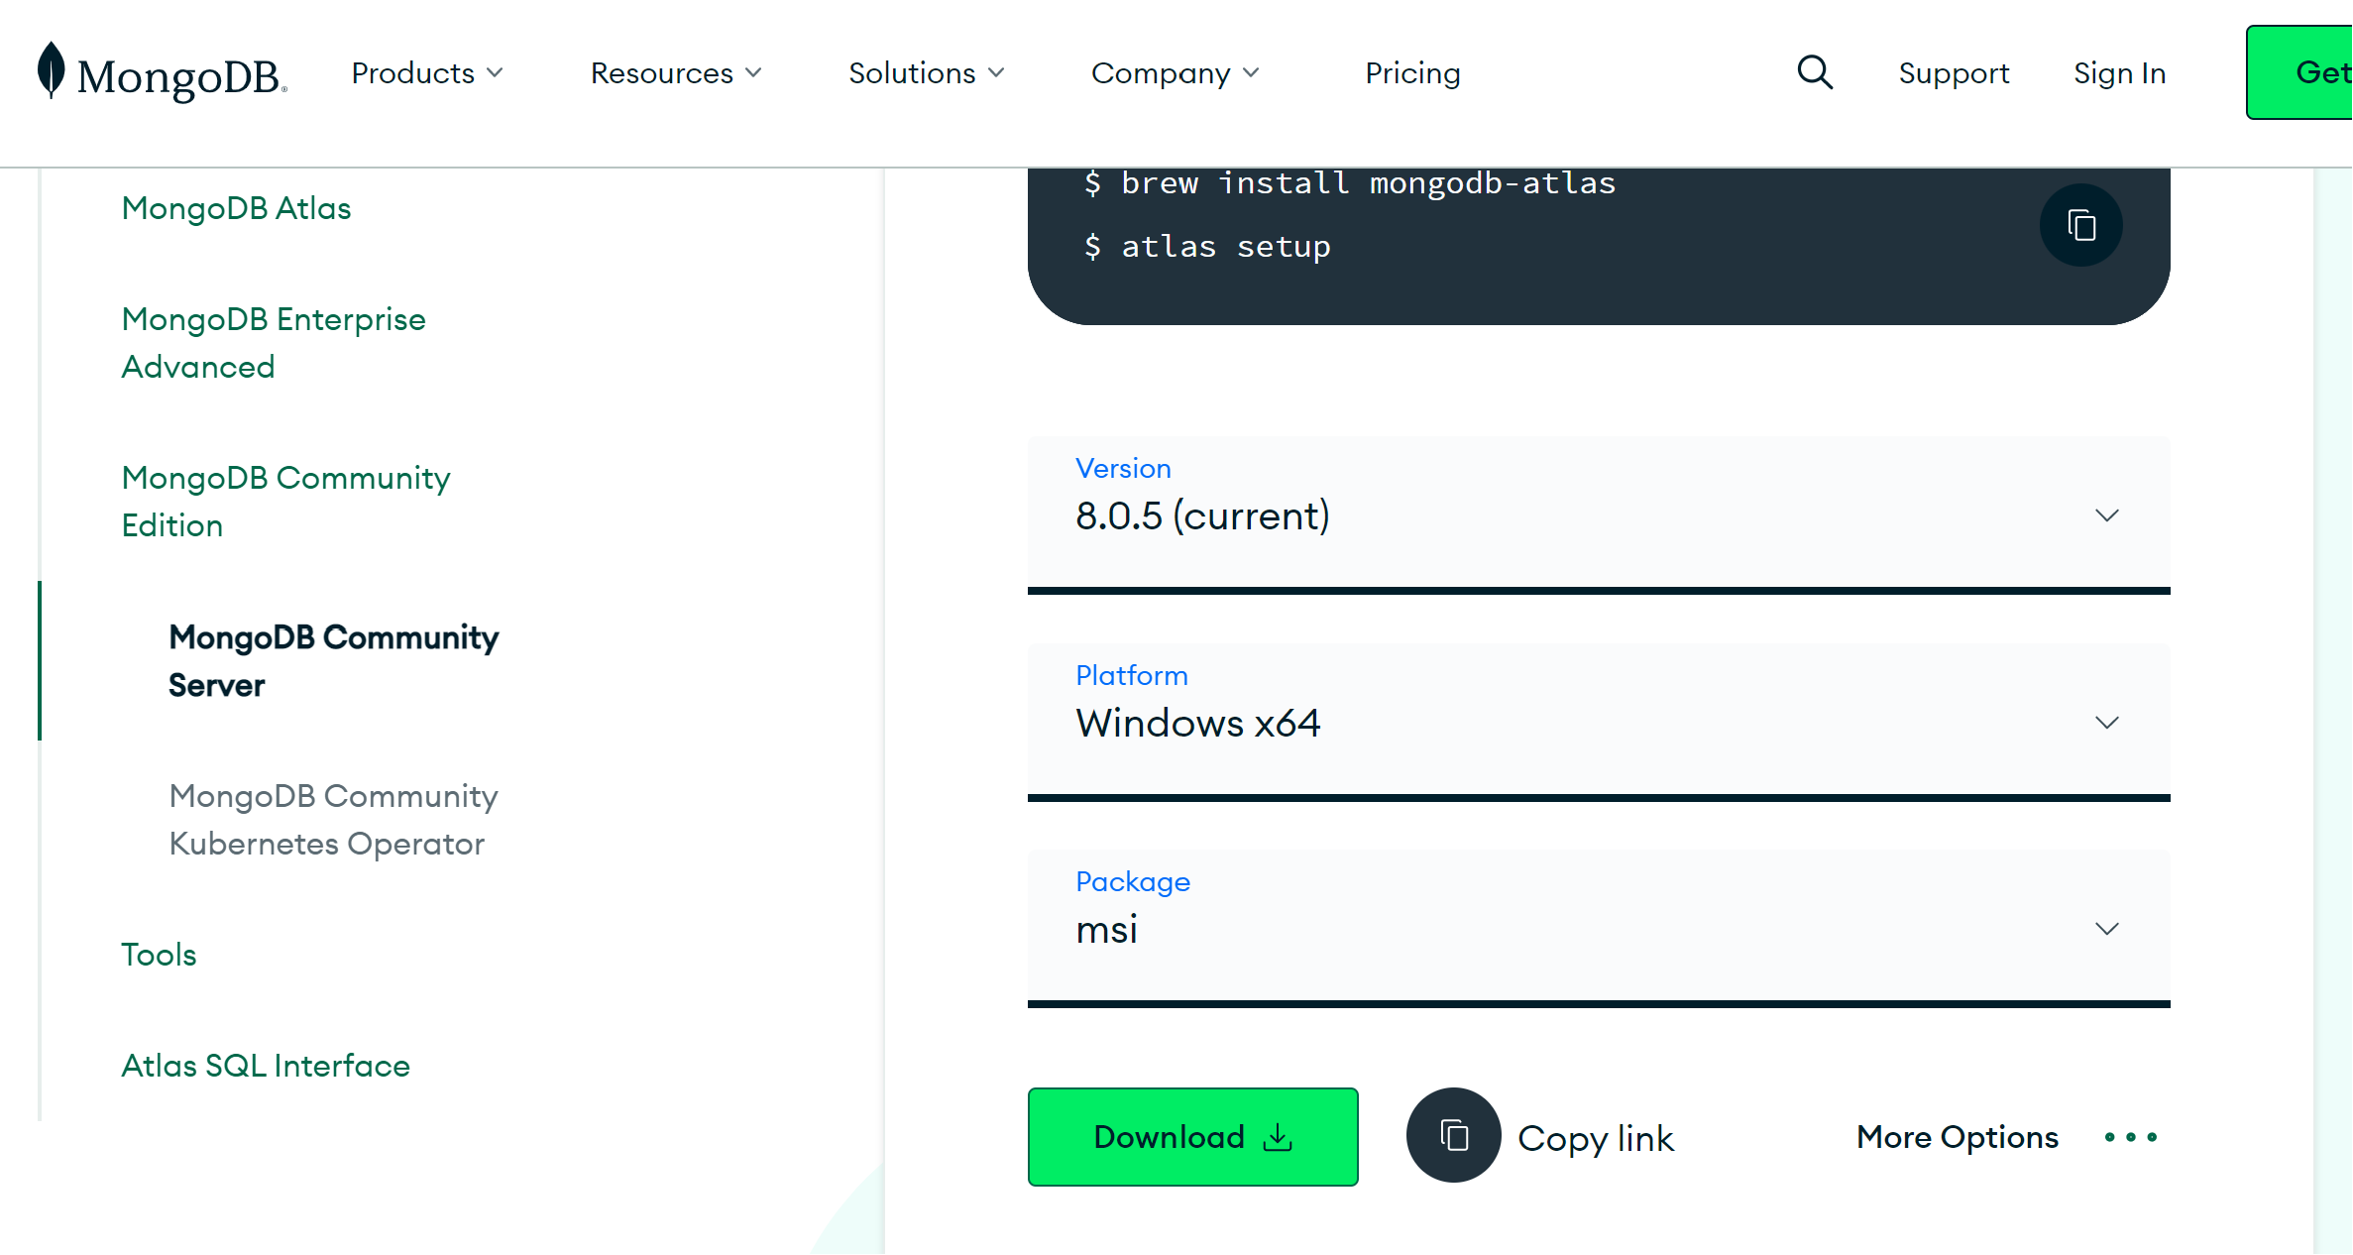
Download Installation File
Go to MongoDB download center https://www.mongodb.com/try/download/community
Notes:
Go to the MongoDB download center. Choose Server, and select the current release version and your computer’s operating system. Then download the MSI installation file.

Slide 7
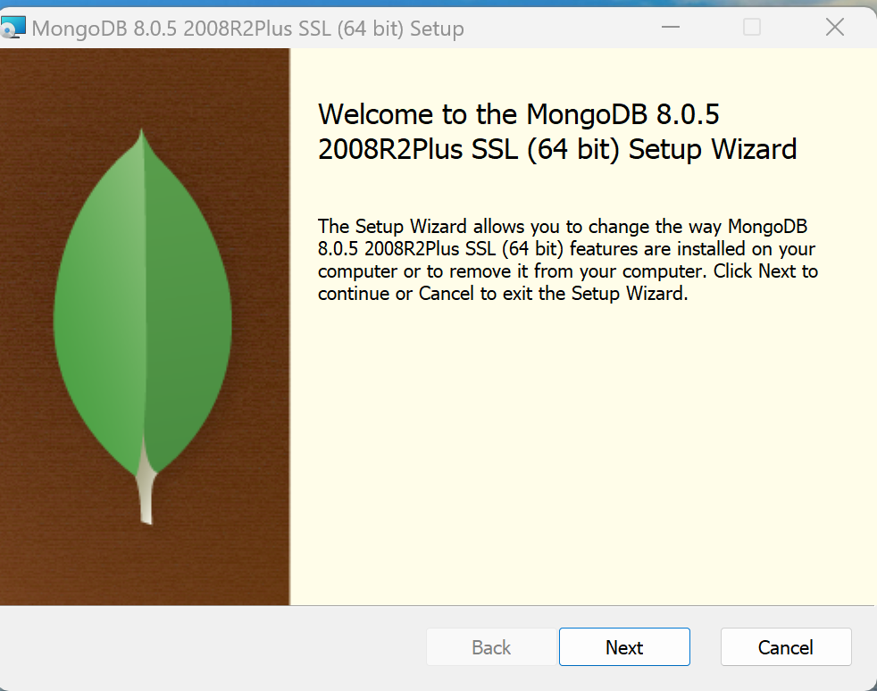
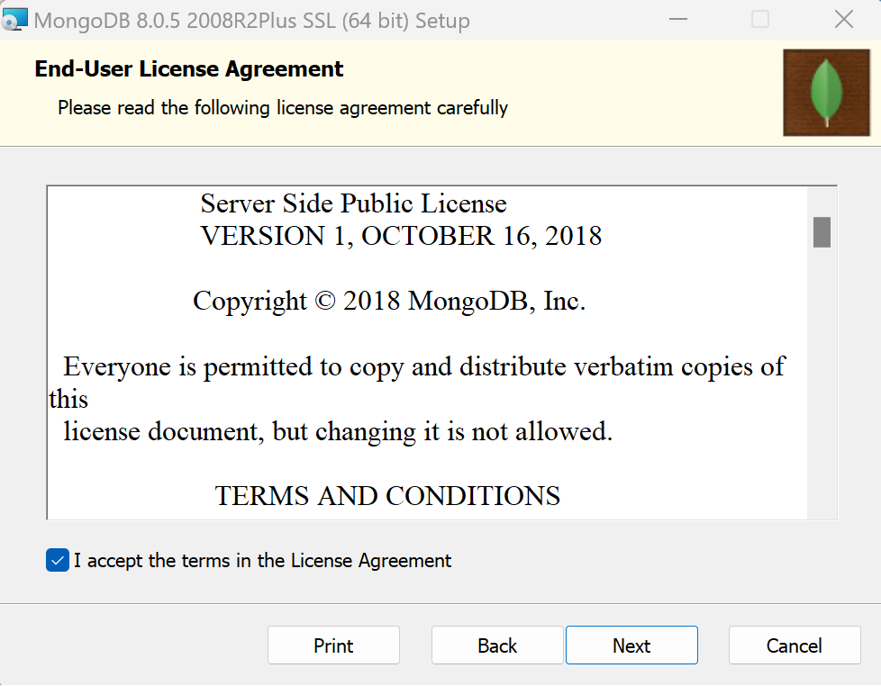
Installing MongoDB
Double click on the .MSI file.

Slide 8
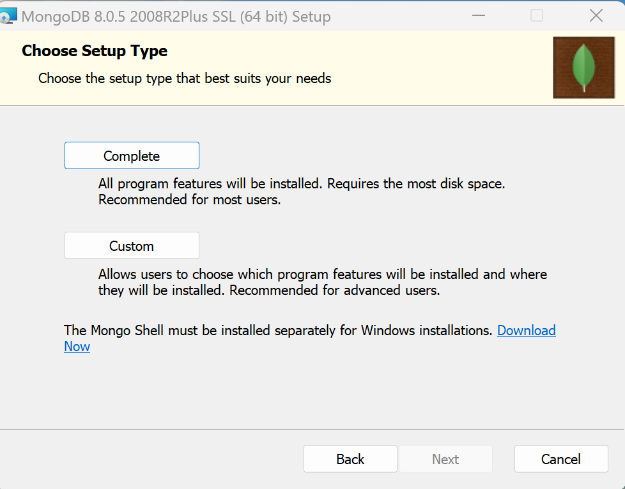
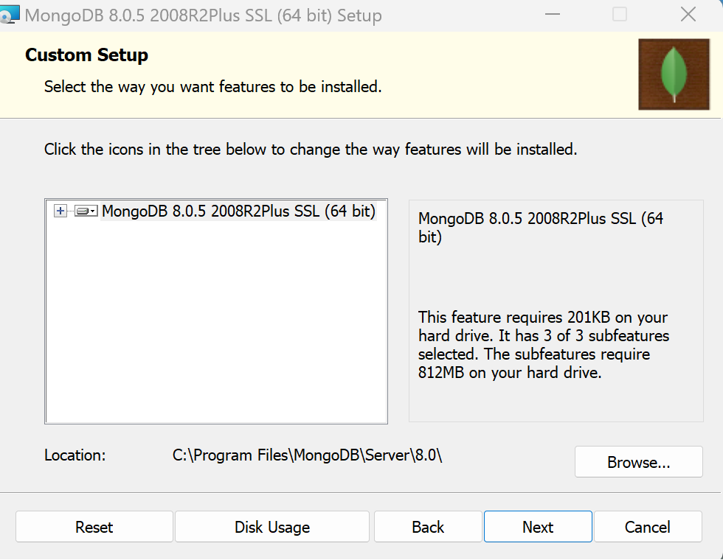
Installing MongoDB
Custom the Installation

Slide 9
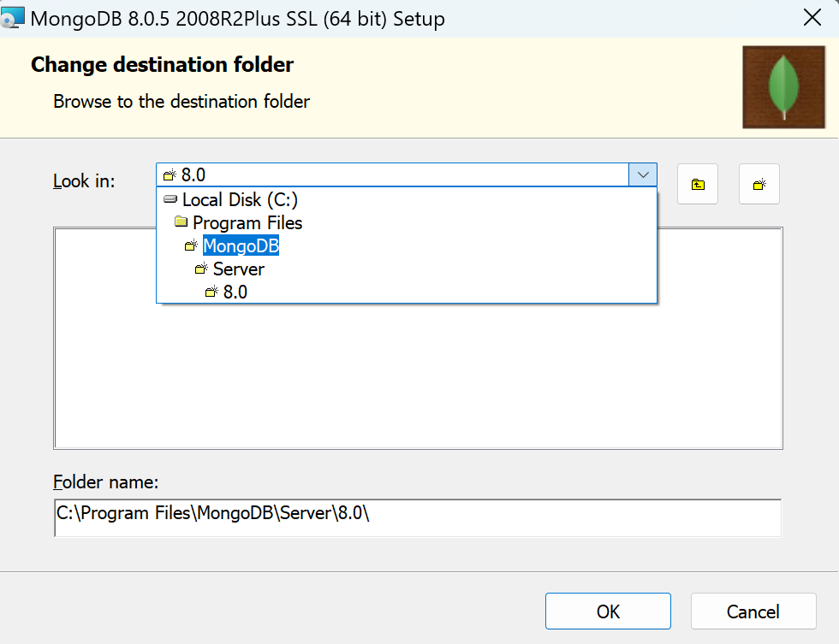
Installing MongoDB
Custom the Installation

Slide 10
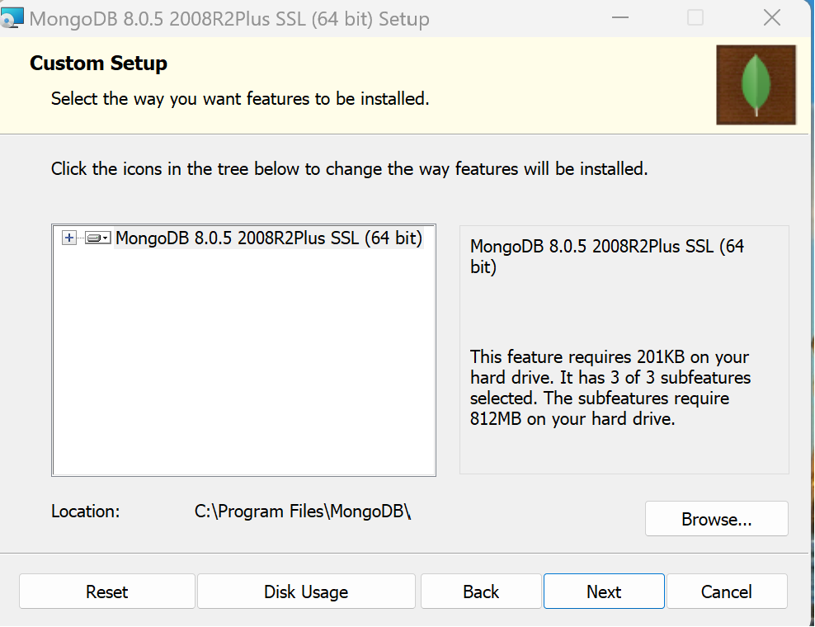
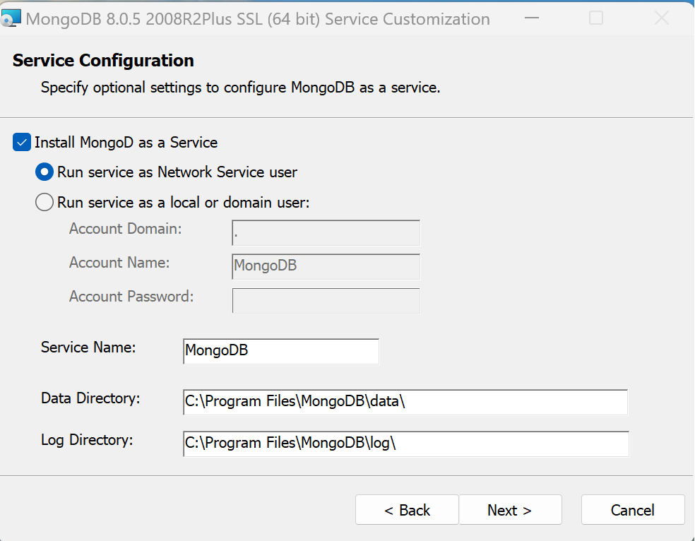
Installing MongoDB

Slide 11

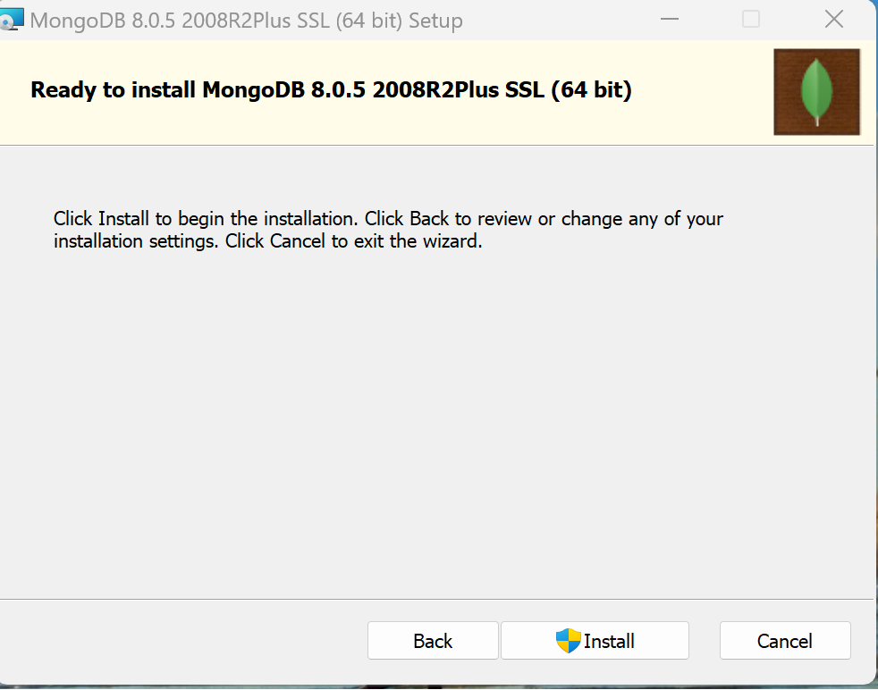
Installing MongoDB

Slide 12
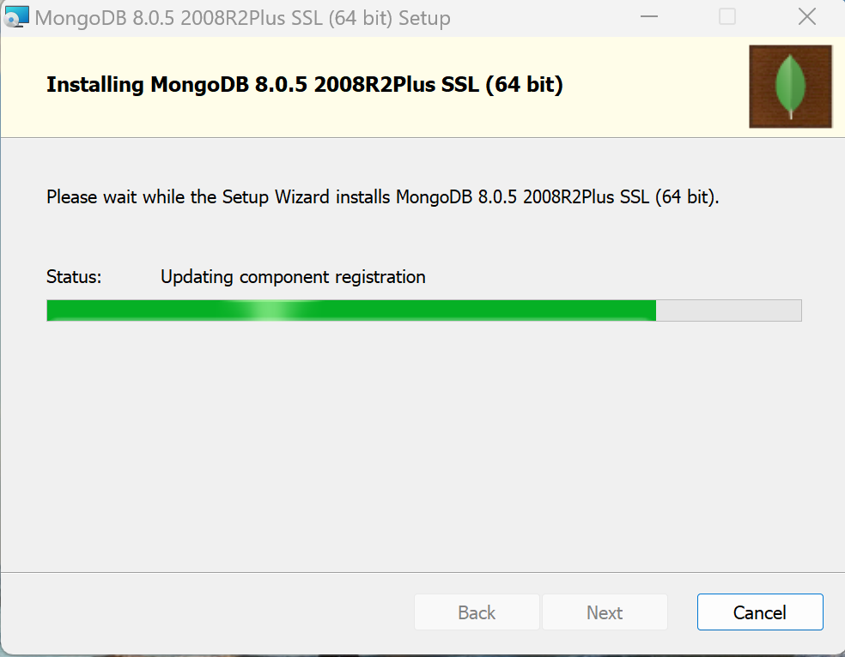
Installing MongoDB

Slide 13
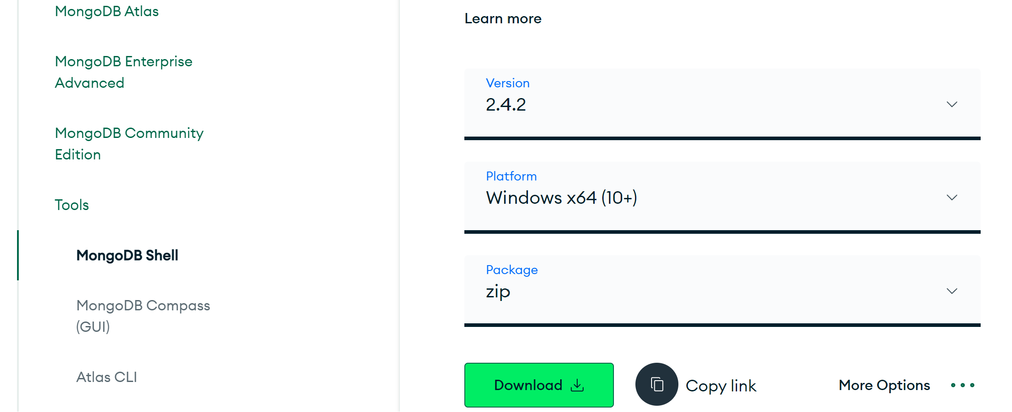
Download MongoDB Shell
Go to MongoDB download center https://www.mongodb.com/try/download/shell

Slide 14
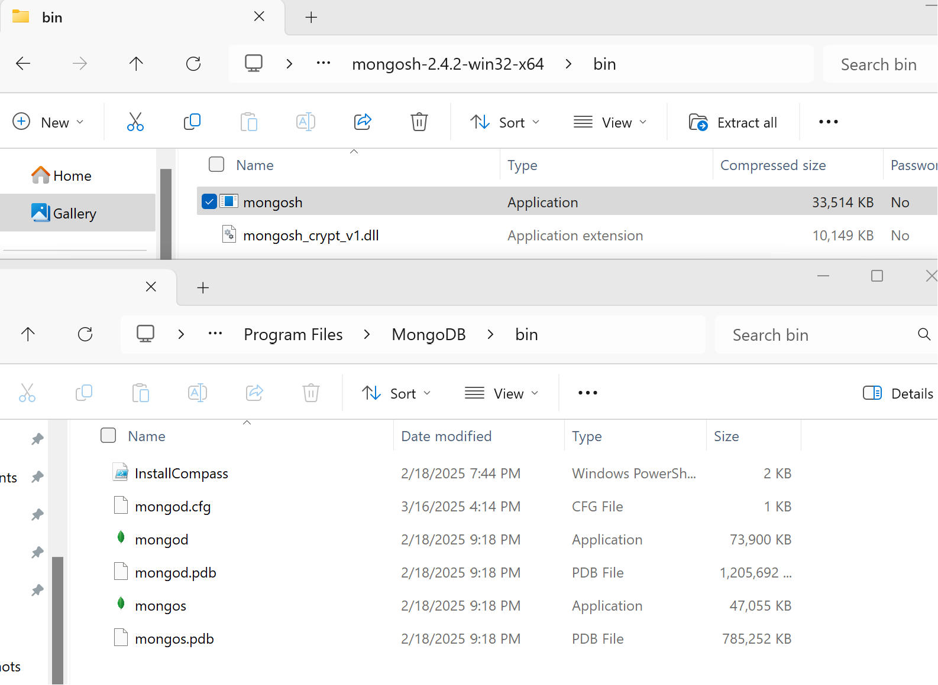
Download MongoDB Shell
Open the downloaded MongoDB Shell file
Go to bin folder
Find and move “mongosh” file to C:\Program Files\MongoDB\bin

Slide 15

Connect to the MongoDB server
Open up the command line
Make sure you run as administrator
Notes:
Just as relational databases can be accessed through a wide range of application programming languages such as JavaScript, Java, Python, and PHP, so can MongoDB. MongoDB also provides a built-in MongoDB shell program that provides an interface for working directly with the data. Using the shell, data is queried using Mongo Query Language (MQL). MQL is based on JavaScript, and many of the programming features of JavaScript, such as IF statements, variable declaration and manipulation, and looping, are available directly in MongoDB. Although full JavaScript programming is beyond the scope of this course, it is important to consider basic data manipulation in MQL.
MongoDB databases comprise collections of documents. Each MongoDB server can host many databases. Within the MongoDB server (also called the host), each database is a type of object. As we know from the previous discussion of JSON format, objects can contain other objects. A database object contains collections. Collections are also objects. Collection objects contain document objects. In addition to holding data content, an object can also have methods, which are programmed functions for manipulating the object.
First, we need to connect to MongoDB server.

Slide 16
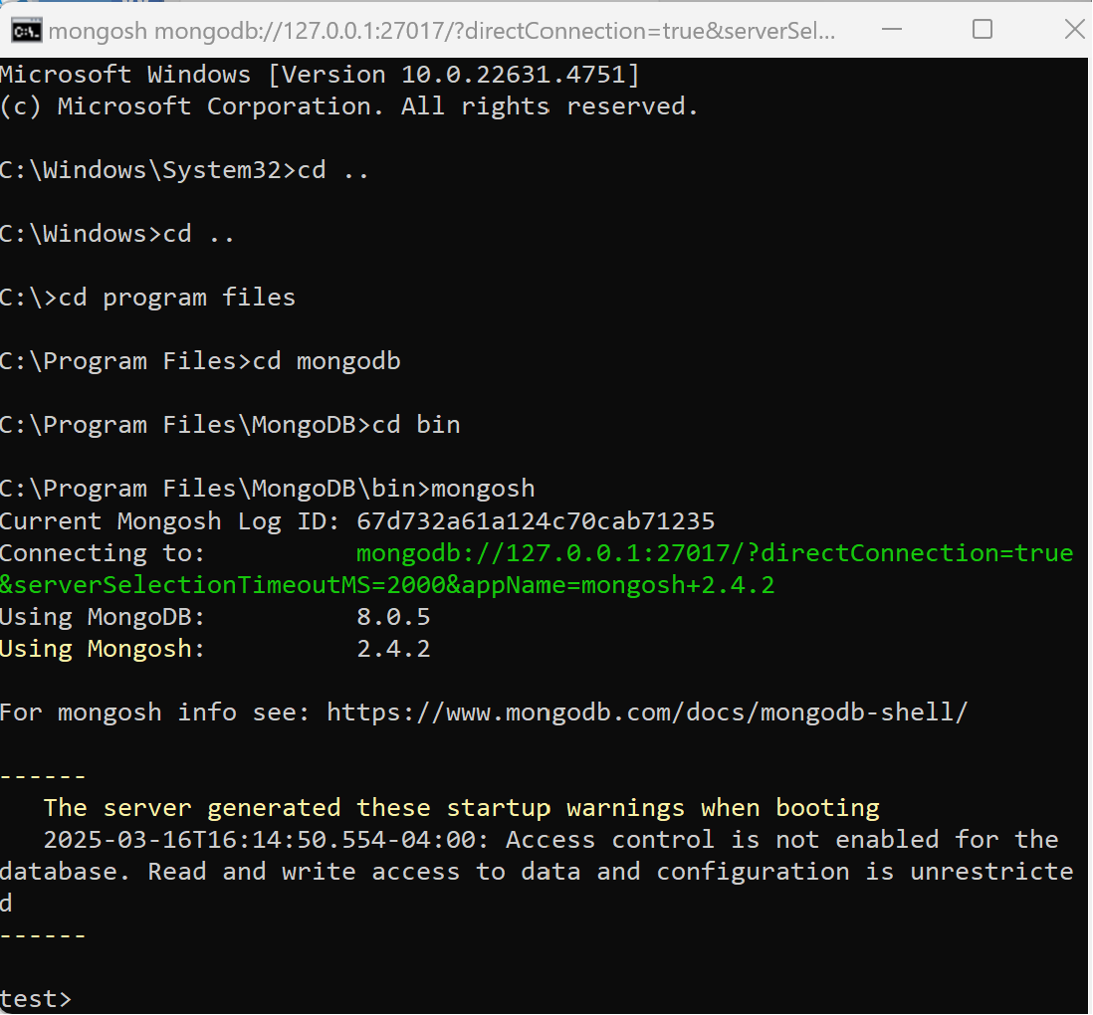
Connect to the MongoDB server
Navigate to the bin folder: C:\Program Files\MongoDB\bin
Then, start MongoDB shell by typing mongosh

Slide 17
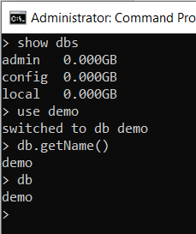
Show and Create Databases
Show databases: show dbs
Create or navigate a database: use DatabaseName
Check the database name or which database you are in:
db.getName()
Or, db
Notes:
To show us the list of databases, we can do “show dbs”. It shows that there are three default databases called admin, config, and local.
All data manipulation commands in MongoDB must be directed to a particular database. To create a database, we specify: use DatabaseName. The use command informs the server which database is to be the target of the commands that follow. If there is a database with the name specified, then that database will be used for the subsequent commands. If there is not a database with that name, then one is created automatically. For example, here we create a database named demo. We will also use this database in other following exercises.
The name of the database that is being used can be displayed using the getName() method on the db variable. Or, if you want to check which database you are in, you can simply type db.

Slide 18
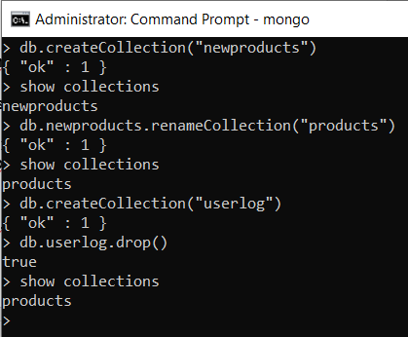
Creating and Manipulating Collections
Create collection: db.createCollection(<“CollectionName”>)
Display collections: show collections
Rename a collection: db.renameCollection(<“NewName”>)
Drop a collection: db.<CollectionName>.drop()
Notes:
To create a collection, we use the createCollection(). For example, if we create a collection named newproducts inside the demo database, we do db.createCollection(“newproducts”).
To display the collections that exist in a database, we use the command show collections.
To rename a collection we use the renameCollection() method of the collection, and provide the new name for the collection as a parameter. For example, db.newproducts.renameCollection(“prodcts”), this will rename the newproducts collection to products. Using the show collections command, you can see that the collection name has changed.
Dropping a collection removes all documents in the collection and deletes any indexes that have been created with that collection. Dropping the collection is done with the drop() method of the collection. The drop() method does not require any options or parameters. It drops whichever collection that it was called with. For example, we create a userlog collection (db.createCollection(“userlog”)) and then drop it (db.userlog.drop()).

Slide 19
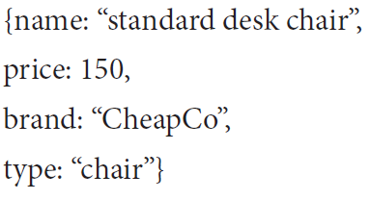
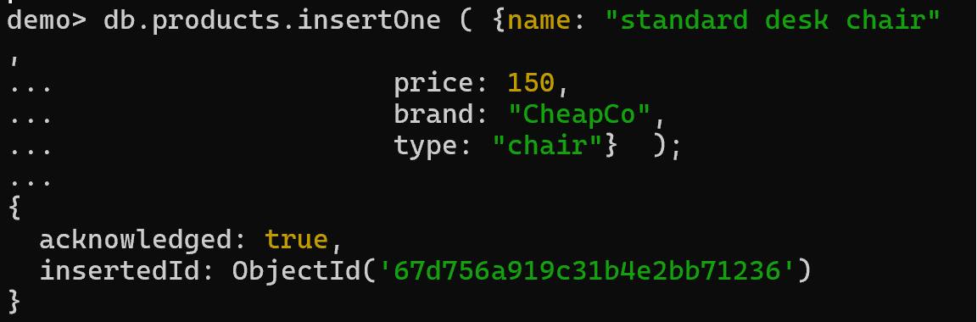
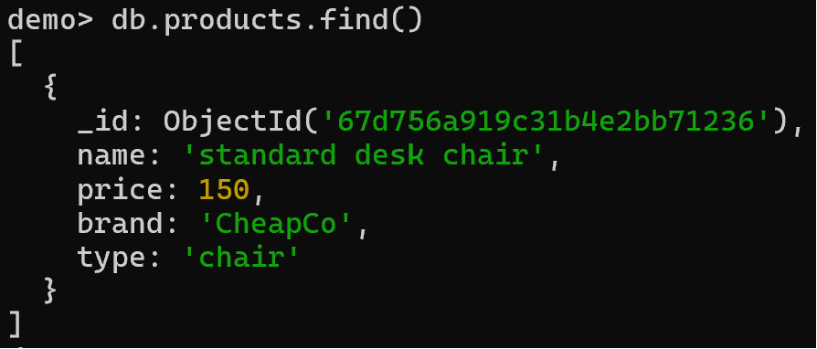
Insert Documents
Syntax:
Add one document: db.<collection name>.insertOne({document})
Add multiple documents: db.<collection name>.insertMany({document})
Example: Insert the following document to the product collection
Retrieving documents: db.<collection name>.find()
Notes:
Once a collection has been created, documents can be added to it. The insert() method of the collection is used to add new documents to the collection. The syntax for the insert() method in MongoDB is db.<collection name>.insert({document}).
For example, here we insert one document to the product collection ………
Retrieving documents in MongoDB will be explored in greater detail later in this chapter; however, for now we can retrieve the documents in our collection using the find() method - db.<collection name>.find().
Notice that each document has a key named _id that contains an ObjectID. The default for new collections is to have the autoIndexID property set to true so the _id column is generated automatically when documents are inserted. The _id values generated in your collections will differ from the ones shown here because characteristics of the host computer become encoded as part of the _id field, but they will always be unique within your collection.

Slide 20
Insert Documents
Syntax:
Insert one document: db.<collection name>.insertOne({document})
Insert multiple documents: db.<collection name>.insertMany([{document1}, {document2}, {document3}])
Example Codes:
db.products.insertOne( {name: "cushioned desk chair",
brand: "RoughRider",
type: "chair",
keywords: ["chair", "office", "cushioned"],
price: 300});
db.products.insertOne( {name: "cushioned desk chair",
brand: "RoughRider",
type: "chair",
keywords: ["chair", "office", "cushioned"],
price: 300});
Notes:
Next, let’s insert another document in the same collection, but with a slightly different structure. Remember, document databases are schema-less so all of the documents in a collection are not required to have the same structure.
The insert() method can be used with JSON documents of any complexity. Here we include an array of values for the keywords key.
We can check it using db.products.find(). Here we see this new document is inserted.

Slide 21
Updating Documents
A replacement update completely removes the original document and replaces it with the new document while preserving only the value of the _id primary key.
An operator update makes changes to some of the content of a document, but leaves the remainder of the document unchanged.
While earlier versions of MongoDB use the same syntax, the newer versions have separates syntax for the two types of updates.
Syntax:
db.<collection name>.replaceOne({<query>}, {<change>}, <upsert>, <multi>)
db.<collection name>.updateOne({<query>}, {<change>}, <upsert>, <multi>)
Note: “One” also can be replaced as “Many”
Query: which documents to update
Change: what changes to make to the document
Upsert: False (default): if no document meets the criteria in the query object, then no changes; True: if no document meets the criteria, insert a new document with the data in the change object
Multi: False: only the first documents that match the criteria will be updated; True: all documents meets the criteria will be updated.
Notes:
There are many options when updating documents in MongoDB. At the most basic level, updates can either be operator updates or replacement updates. An operator update makes changes to some of the content of a document, but leaves the remainder of the document unchanged. This is similar to an update in a relational database. A replacement update completely removes the original document and replaces it with the new document while preserving only the value of the _id primary key. The syntax for the replacement update method is: db.<collection name>.replaceOne() or db.<collection name>.replaceMany(), depending on the number of documents to update. Similarly, the syntax for the operator update method is: db.<collection name>.updateOne() or db.<collection name>.updateMany(), depending on the number of documents to update.
The update() method can have four parameters.
First is a query object that is used to determine which documents to update. This is like the WHERE clause of a SQL UPDATE command. Only documents that match the query are updated.
The second parameter is a change object that specifies what changes to make to the document. If a replacement update is being performed, then the change object will be the new version of the document to be stored. If an operator update is being performed, then the change object will contain the functions that specify what changes should be made to the document.
The third parameter is the upsert flag. The upsert flag is Boolean, that is, it is either true or false. By default, upsert is false. If upsert is false, then if no documents match the criteria in the query object, then no changes will be made to the collection. On the other hand, if upsert is set to true, then if no documents match the criteria in the query object, then a new document will be inserted with the data in the change object. Upsert combines an update and an insert, hence the name. If there is a match, it performs an update; if there is not a match, it performs an insert.
The fourth parameter is the multi flag. Like upsert, multi is Boolean and false by default. If multi is false, then only the first document found to match the query object will be updated. If multi is set to true, then all documents found to match the query object will be updated. Both the upsert and multi flags can be omitted to apply the default values of false for those flags.

Slide 22
Replacement Updates
Example: a replacement update on the “standard desk chair” document that was first inserted into the products collection
db.products.replaceOne({name: "standard desk chair"},
{name: "regular desk chair"},
false,
false);
Notes:
Here is an example of replacement update. (db.products.replaceOne………) If we replace the “standard desk chair” document that was first inserted into the products collection. Then we display the updated collection using the find() function. (db.products.find().pretty()) Here we use .pretty() function. This will display the results in a more readable format.
Looking at the first document returned. The entire document for “standard desk chair” has been replaced with a document that contains only the name property. Other properties are removed.

Slide 23
Replacement Updates
The change object can also include multiple key:value pairs, including complex values such as arrays and embedded objects.
db.products.replaceOne({name: "regular desk chair"},
{name: "basic desk chair", price: 100, brand: "RoughRider", type: "chair"});
Notes:
The change object can also include multiple key:value pairs, including complex values such as arrays and embedded objects. Look at this command. (db.products.replaceOne…..) db.products.find().pretty() It replaces the same document with a new version.

Slide 24
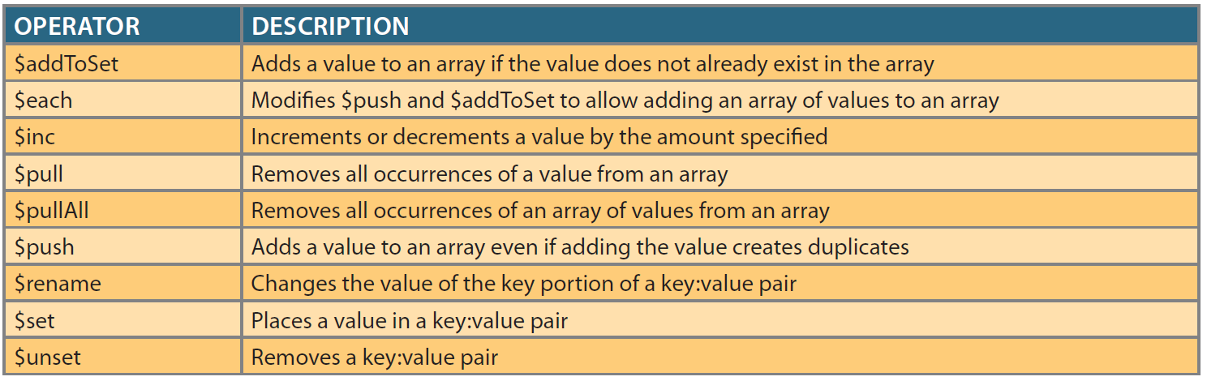
Operator Updates
Operator updates use one or more update functions, or operators, in the change object.
Syntax for an operator:
<operator>: {<object>}
Notes:
Operator updates follow the same syntax as replacement updates, except in the change object. Operator updates use one or more update functions, or operators, in the change object. Common update operators are shown in the table. Notice that MongoDB operators start with a $, and each operator can accept an object as a value. The syntax for an operator is: <operator>: {<object>}

Slide 25
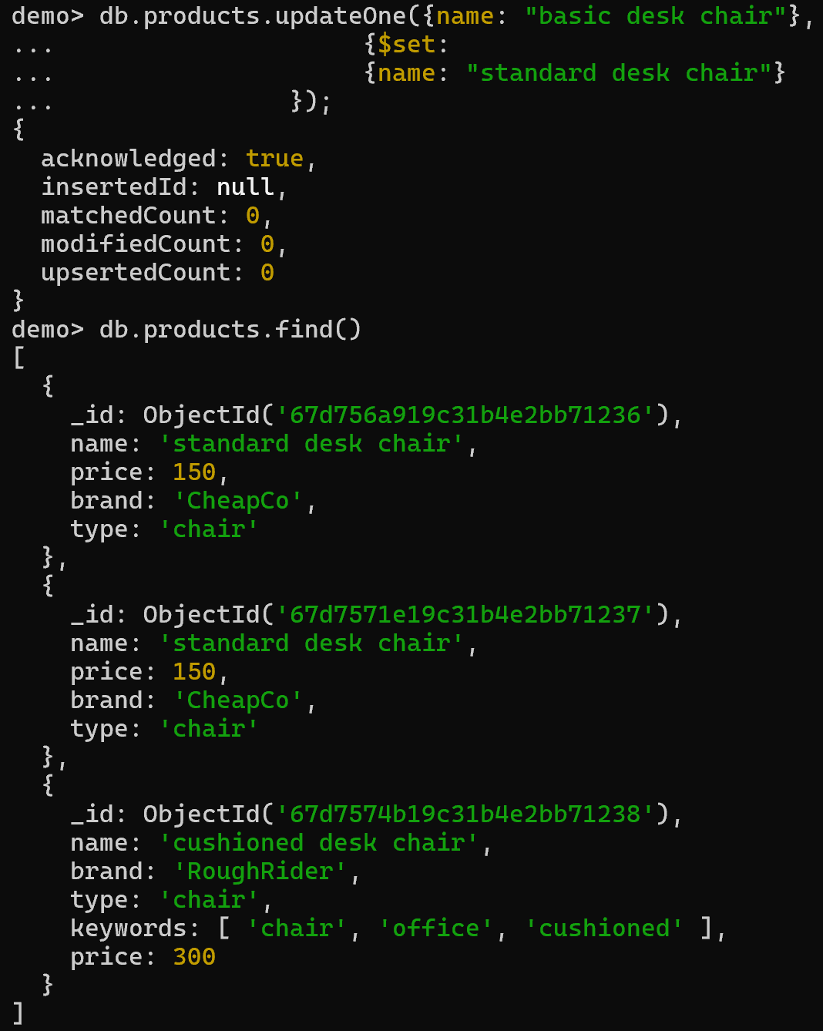
Operator Updates - $set
Notes:
Next, we use three most commonly used update operators as examples to show how to use them.
First, $set operator. The $set operator works much like the SET clause of a SQL UPDATE command. With $set, the programmer specifies the key:value pair to change in the object parameter. For example, the name of the “basic desk chair” from the previous example can be changed using the $set operator. Because this is an operator update instead of a replacement update, the other
key:value pairs in the document are not affected.
From this figure, we can see that, only the name is changed, and all other properties are kept in the document.

Slide 26
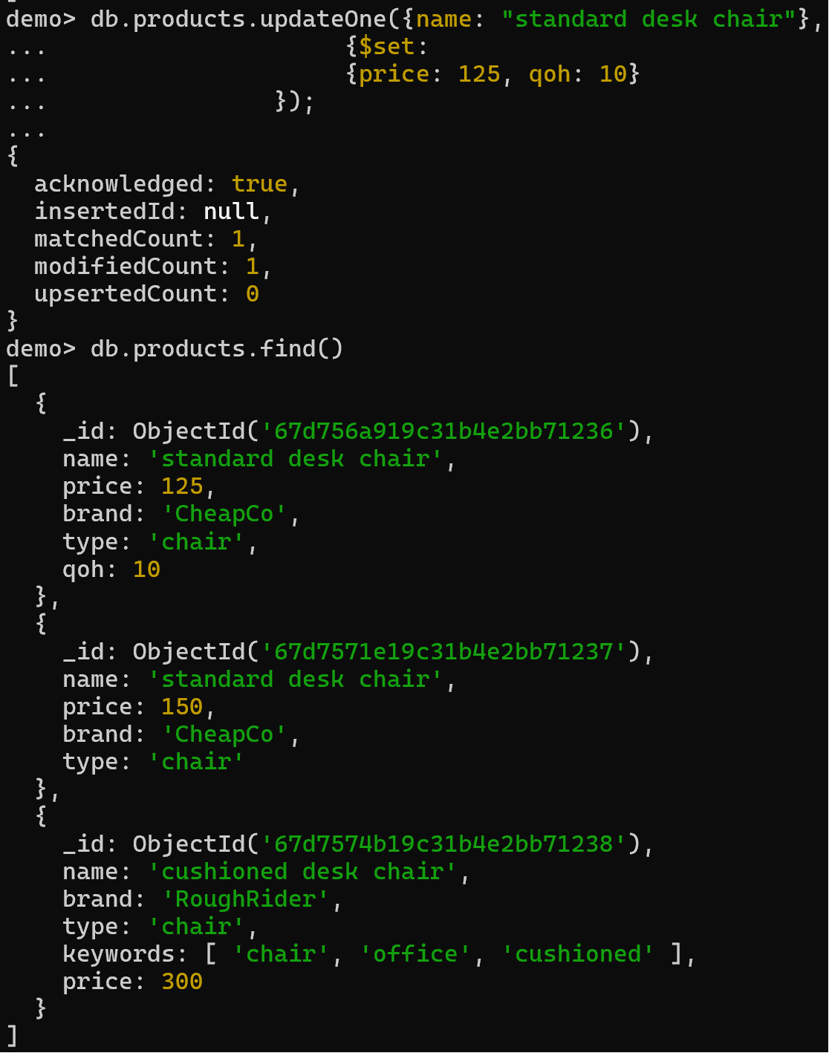
Operator Updates - $set
Notes:
If the key specified in the $set operator’s object parameter exists, then it is updated. If it does not exist, then the key is added to the document with the value specified. For example, this command is used to change the price to 125 and add quantity on hand (qoh) to the document. Here, we can see that the price is updated to 125, and the “qoh” of 10 is added as a new key-value pair.

Slide 27
Operator Updates - $set
db.products.updateOne({name: "standard desk chair"},
{$set:
{brand:
{name: "CheapCo",
phone: "555-1212"}
}
});
Notes:
We also can update a key to contain a subdocument. For example, this command changes the brand key to contain a subdocument.

Slide 28
Operator Updates - $unset
remove a selected key:value pair from a document
db.products.updateOne({name: "standard desk chair"},
{$unset:
{qoh: 1}
});
Notes:
Just as the $set operator can be used to add a new key:value pair to a document, the $unset operator can be used to remove a selected key:value pair from a document. Look at this example, the qoh key is removed.
Note that all operators accept an object parameter. The object parameter must include a minimum of a key:value pair. Since $unset is removing the pair, the actual value provided in the command is immaterial as long as some value is provided. In the previous example, the value “1” is provided for the qoh key. Using the value “1” with $unset is common, but any value would work.

Slide 29
Operator Updates - $inc
Increment or decrement a numeric value
Example: increase the price of chairs by $50
db.products.updateMany({type: "chair"},
{$inc:
{price: 50},
}, false, true);
Notes:
The $inc operator is used to increment or decrement a numeric value. The object parameter for the $inc operator specifies the key whose value is to be changed and the change amount. For example, if we wish to increase the price of chairs by $50, we could use the following command. We can see that the previous prices were 125 and 300, and now they become 175 and 350. Notice that here we set the fourth parameter to True, which updates both chairs that satisfies the criteria.

Slide 30
Updating Values in a Subdocument
db.products.updateOne({name: "standard desk chair"},
{$set:
{"brand.phone": "555-2121"}
});
Notes:
Updating the values in a subdocument can also be done using the $set, $unset, and $inc operators. The only modification is that the name of the subdocument must be added to the name of the key in the subdocument that is to be modified. Dot (.) notation is used when adding the subdocument name to the key name with the format “<subdocument>.<key>.” To ensure that MongoDB correctly interprets the combined name as a single value, the combined name must be placed inside quotes. The following command changes the phone number for the embedded subdocument in the standard desk chair document.

Slide 31
Updating Arrays
Code:
db.products.updateOne({name: "cushioned desk chair"},
{$set:
{keywords: ["chair", "office", "cushioned", "fancy"]}
});
Add “fancy” to the keywords array
The updated keywords array should be: [“chair”, “office”, “cushioned”, “fancy”]
Using $set operator, we need to reset the entire array
Notes:
Changing values in an array can be slightly different. To change the values in an array, it is possible to use the $set operator, but the entire array would have to be set at the same time. The cushioned chair document that was previously inserted included a “keywords” key that contains the array [“chair,” “office,” “cushioned”]. The additional keyword “fancy” could be added to the array using the $set operator if the entire array is reentered, as follows:

Slide 32
Updating Arrays Using $push Operator
$push operator: add a value to an array
Example: add the keyword “elegant” to the cushioned chair document
db.products.updateOne({name: "cushioned desk chair"},
{$push:
{keywords: "elegant"}
});
Notes:
Although this produces the required result, it is not normal practice. In most cases, the programmer is attempting to add or remove values from the array, not replace every value in the array. Using $set in this situation is inefficient because it would require first retrieving the entire array to know which values already exist in the array so that they can be included in the update operation. Typically, values are added to or removed from the array without having to retrieve the array first. This is done using the $push and $pull operators.
The $push operator is used to add a value to an array. The $pull operator is used to remove a value from an array. Other values in the array are unaffected by $push and $pull.
For example, to add the keyword “elegant” to the cushioned chair document, we can use ….. The query object tells the update() method to find a document with the value “cushioned desk chair” in the name key. The change object tells the method to push, or add, the value “elegant” to the array of values for the keywords key. Since the upsert and multi flags were omitted, they take the default value of false.

Slide 33
Updating Arrays Using $pull Operator
$pull operator: remove a value from an array
Example: remove the keyword “office” from the array
db.products.updateOne({name: "cushioned desk chair"},
{$pull:
{keywords: "office"}
});
Notes:
The $pull operator has the exact same syntax as the $push operator. The only difference is that $pull removes the value from the array instead of adding it to the array. The keyword “office” can be removed from the array using the $pull operator.
As we can see from these two example, the other values in the array were not impacted.

Slide 34
Updating Arrays Using $addToSet Operator
The $push operator allows duplicate array values.
The $addToSet operator has the same syntax with $push, but does not add a value to the array if the value already exists in the array.
Example: add the value “expensive” to the keywords array
db.products.updateOne({name: "cushioned desk chair"},
{$addToSet:
{keywords: "expensive"}
});
Notes:
It is possible, and in some cases desirable, for an array to contain duplicate values. If an array contains a list of websites visited by a user, we may wish to know every time the user visited a given website even if that means the website appears in the array multiple times. Other times, we do not want duplicates to appear in an array. In the keywords for our cushioned chair, there is no advantage to storing the keyword “elegant” multiple times. The $push operator allows duplicate array values. If you were to re-execute the earlier command to push “elegant” to the keywords array, the value would appear more than once. To allow programmers to add a value to an array only if the value does not already exist in the array, the $addToSet operator is used. The $addToSet operator uses the same syntax and operates in the same manner as the $push operator except that it does not add a value to the array if the value already exists in the array.
Let’s add the value “expensive” to the keywords array. This command adds “expensive” to the keyword array because the value “expensive” was not already in the array.

Slide 35
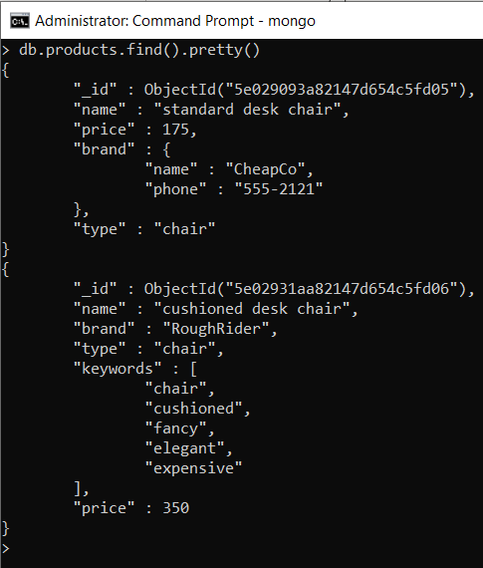
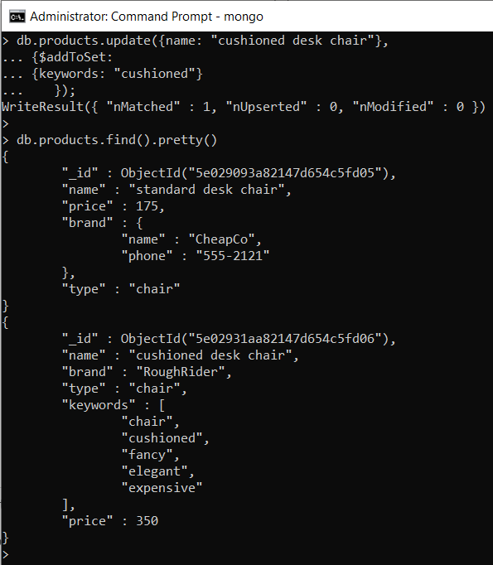
Updating Arrays Using $addToSet Operator
Before updating
After updating
Notes:
If you use the $addToSet operator with a value that already exists in the array, the value will not be added again. For example, we add “cushioned” to the cushioned desk chair document’s keywords array. We can see that the keywords are same before and after the update.
If a value appears in an array multiple times, the $pull operator will remove every occurrence of that value from the array.

Slide 36
Updating Arrays with Arrays using $pullAll
To remove an array of values from an existing array, use the $pullAll operator instead of the $pull operator.
Example: remove the values “fancy,” “expensive,” and “cushioned” from the keywords array
db.products.updateOne({name: "cushioned desk chair"},
{$pullAll:
{keywords: ["fancy", "expensive", "cushioned"]}
});
Notes:
The previous operators are very good at working with individual values in arrays, whether it is a single, simple value or an object value. However, since arrays are designed to hold multiple values, we often want to modify the contents of an array with multiple values simultaneously. It is not possible to update an array with an array of values using $push, $pull, and $addToSet.
Luckily, only small modifications are needed to accomplish this task. To remove an array of values from an existing array, use the $pullAll operator instead of the $pull operator. The $pullAll operator syntax is the same as the $pull operator except that it accepts an array of values instead of a single value. Let’s remove the values “fancy,” “expensive,” and “cushioned” from the keywords array, as shown here.

Slide 37
Updating Arrays with Arrays using $each
The $push and $addToSet operators can be used in conjunction with the $each operator. The $each operator modifies $push and $addToSet to iterate, or loop, over a set of values and act on each one separately.
Example: add the values “heavy duty,” “leather,” and “adjustable” to the keywords array
db.products.updateOne({name: "cushioned desk chair"},
{$push:
{keywords:
{$each: ["heavy duty", "leather", "adjustable"]}
}
});
Notes:
The $push and $addToSet operators can be used in conjunction with the $each operator. The $each operator modifies $push and $addToSet to iterate, or loop, over a set of values and act on each one separately. For example, if we want to add the values “heavy duty,” “leather,” and “adjustable” to the keywords array, we use the command combines $push and $each to complete that task, as shown in the figure.

Slide 38
Updating Arrays with Arrays using $each
Example: add the values “arms,” “heavy duty,” and “executive” to the keywords array
db.products.updateOne({name: "cushioned desk chair"},
{$addToSet:
{keywords:
{$each: ["arms", "heavy duty", "executive"]}
}
});
Notes:
The $each operator also can be similarly used with the $addToSet operator. If we want to add the values “arms,” “heavy duty,” and “executive” to the keywords array, we do ….
From the results, we see that the value “heavy duty” appears only once because $addToSet does not create duplicate values in the array.

Slide 39
Updating to Rename Keys with $rename
$rename operator: change the key in the key:value pair
Syntax for an operator:
<operator>: {<object>}
Syntax for $rename operator:
$rename: {<old_name>:<“new_name”>}
Example: renames the price key to saleprice for all documents in the collection
db.products.updateMany({},
{$rename:
{price: "saleprice"}
});
Notes:
All of the previous update operations have worked on changing the values in key:value pairs. It is also possible to change the key in the key:value pair by using the $rename operator. The $rename operator also uses an object parameter. In this case, the object parameter contains a simple, text key:value pair in which the key contains the name of the key to be renamed, and the value is the text that the key name should be changed to, as in {<old_name>:<“new_name”>}. The value component that contains the new name is read by MongoDB as a value when it is checking the syntax of the command. So, the new value must be inside quotes because it is a text value.
Notice that the query object in this command is empty. Including a query object is required, but the object is allowed to be empty. An empty query object matches every document, so combined with the multi flag being set to true, the update operation is performed on every document in the collection.

Slide 40
Deleting Documents
Syntax: db.<collection name>.deleteOne({<query>})
Example: delete the standard desk chair document
db.products.deleteOne({name: "standard desk chair"})
Notes:
Documents are deleted using the remove() method of the collection. The remove() method accepts a single query object as a parameter. Documents that match the query object are deleted from the collection. As with the update() method, the query object can be an empty object, which would delete every document in the collection, but that is rarely used in practice.
For example, if we want to delete the standard desk chair document, we do ….

Slide 41
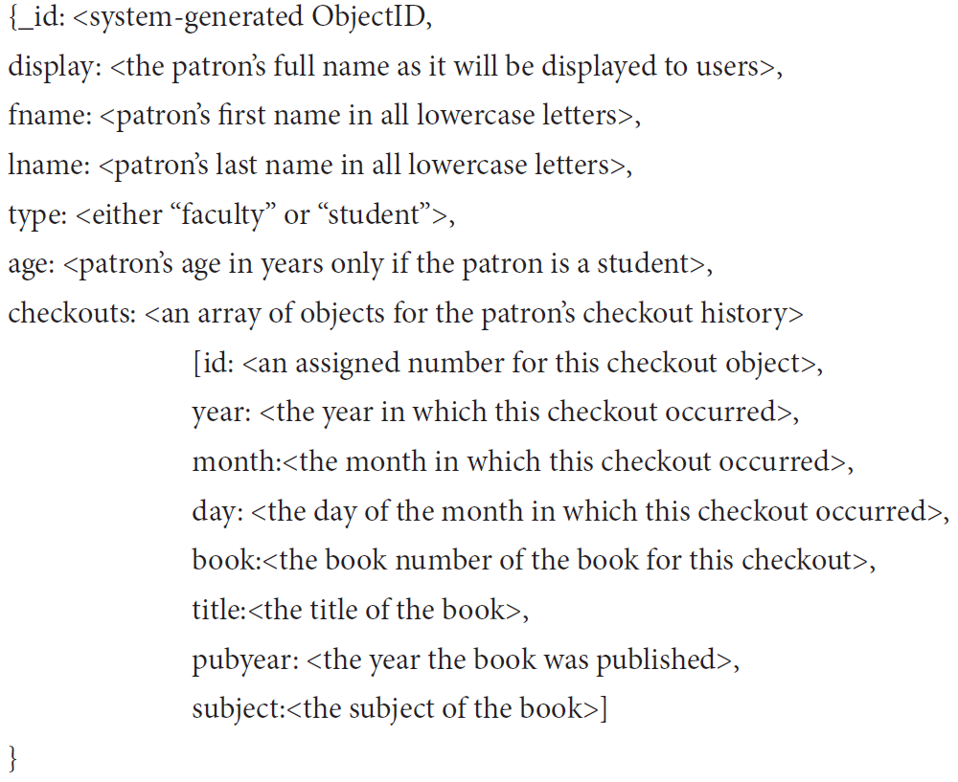
Querying Documents
The dataset: Free Access to Computer Technology (FACT), a small library run by the Computer Information Systems department at Tiny College.
It consists of documents with patron as the central entity.
Data structure:
Notes:
In this video, we demonstrate how to query documents in MongoDB.
The collection of documents used here is based on the data of a small library. The portion of the model that is being used consists of documents with patron as the central entity. The documents have the following structure:
Notice that the patron’s name is stored twice, once with first and last name together with capitalization, and again with first name and last name in all lowercase letters in separate key:value pairs. All searches in MongoDB are case sensitive by default. Making a query case insensitive typically requires the use of a programming technique called regular expressions, which can be very detrimental to performance for MongoDB. Therefore, it is common in practice to store text values in which capitalization matters twice: once capitalized the way it should be displayed, and once in all uppercase or lowercase letters to simplify queries.

Slide 42
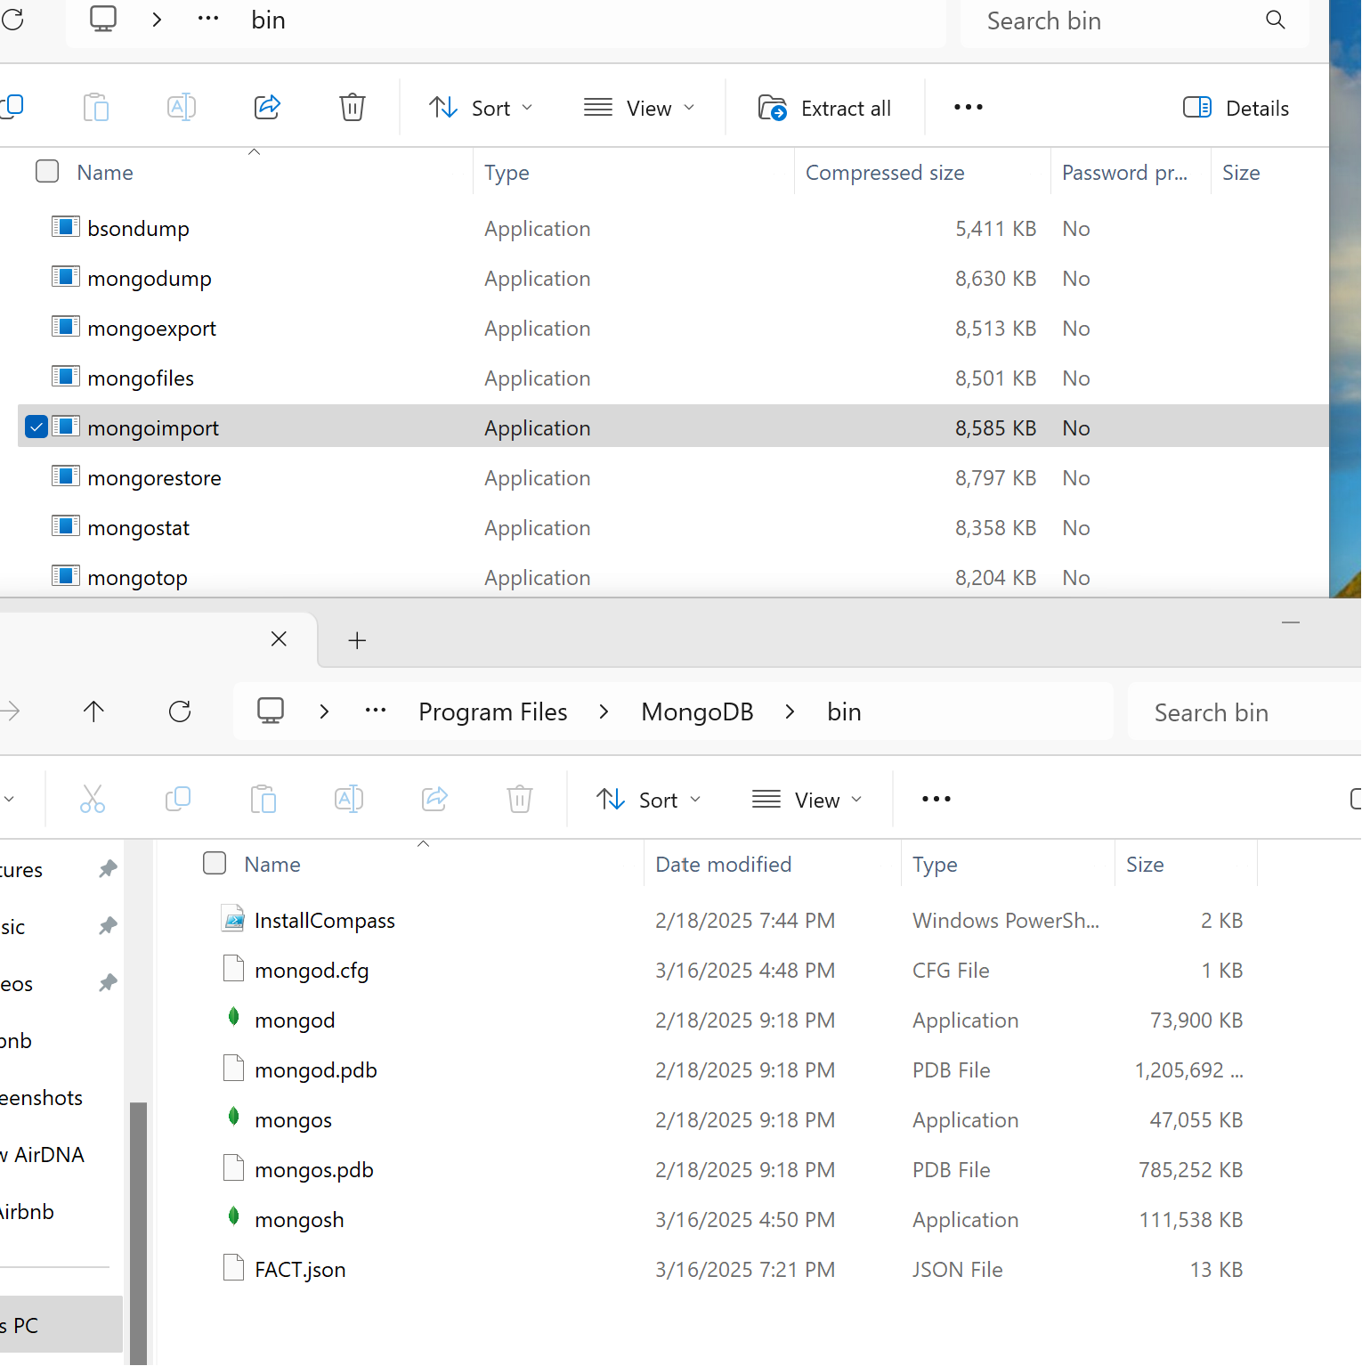
Importing Data File
Copying the data file (FACT.json) to the working directory C:\Program Files\MongoDB\bin
Download MongoDB Database Tools (https://www.mongodb.com/try/download/database-tools); Copying the MongoImport file to the working directory C:\Program Files\MongoDB\bin
Notes:
The following section uses the fact database and the patron collection. The database can be created using the Fact.json file. To import the data file, we first copy the data file to the working directory, which is the bin folder of MongoDB. Then, we start the Command Prompt as administrator, note that not the Mongo Shell.
In the Command Prompt, we first navigate to the bin folder. And then use this command to import the data.
Mongoimport is an executable program that is installed with MongoDB that is used to import data into a MongoDB database. Starting with MongoDB 4.4, mongoimport is now released separately from the MongoDB Server and uses its own versioning.
The above command specifies that the imported documents should be placed in the fact database (if one does not exist, it will be created) and in the patron collection (if one does not exist, it will be created). Mongoimport can work with different file types such as CSV files and JSON files. The type parameter specifies that the imported documents are already in JSON format. The file parameter specifies the file name of the file to be imported. If your copy of the Fact.json file is not in the current directory for your command prompt, you will need to provide an appropriate path for the file location.

Slide 43
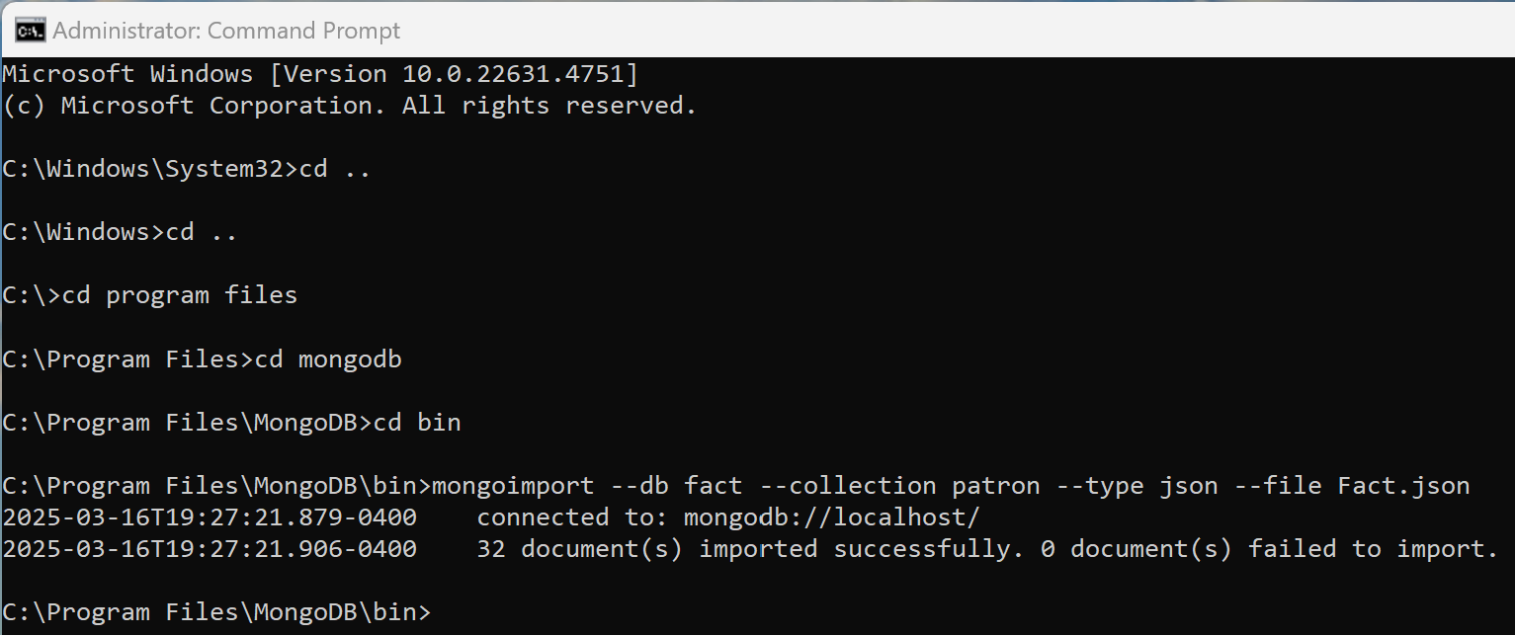
Importing Data File
Navigate to the bin folder
Importing the data by typing:
mongoimport --db fact --collection patron --type json --file Fact.json

Slide 44
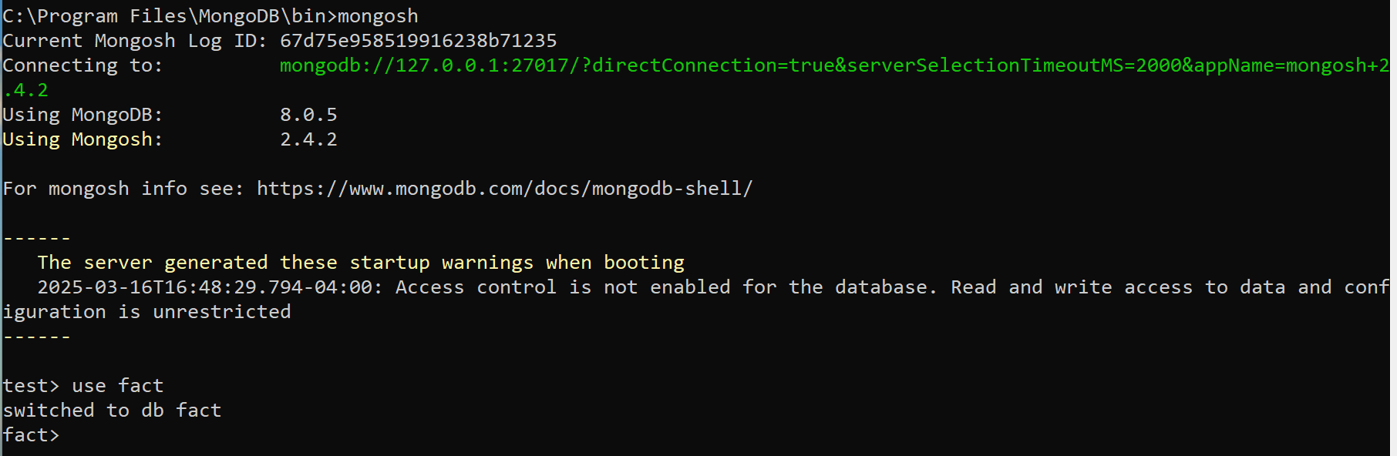
Navigating to the Data File
Execute Mongo shell: mongosh
Change to the fact database: use fact
Notes:
Next, same as before, we execute Mongo Shell to write queries. In the command lines, write mongosh to start the shell.

Slide 45
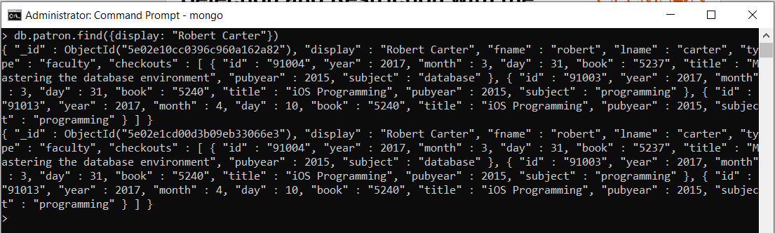
Selection and Restriction with the find() Method
The find() method of a collection retrieves documents from the collection that match the restrictions provided.
Syntax: find({<query>}, {<projection>})
Example: retrieve the patron with the display name “Robert Carter”
Code: db.patron.find({display: "Robert Carter"})
Notes:
As shown previously, the basic method used to retrieve documents in MongoDB is the find() method. The find() method of a collection retrieves documents from the collection that match the restrictions provided. The method accepts two object parameters: the query object that specifies criteria that the documents must match to be included and a projection object that specifies which keys will be included in the returned documents. Both parameters are optional. The syntax for the find() method is: find({<query>}, {<projection>})
The query object parameter functions similar to the WHERE clause of a SQL SELECT query. Providing a simple key:value pair in the query parameter is interpreted as an equality condition. For example, to retrieve the patron with the display name “Robert Carter”, we use this command db.patron.find({display: "Robert Carter"}).

Slide 46
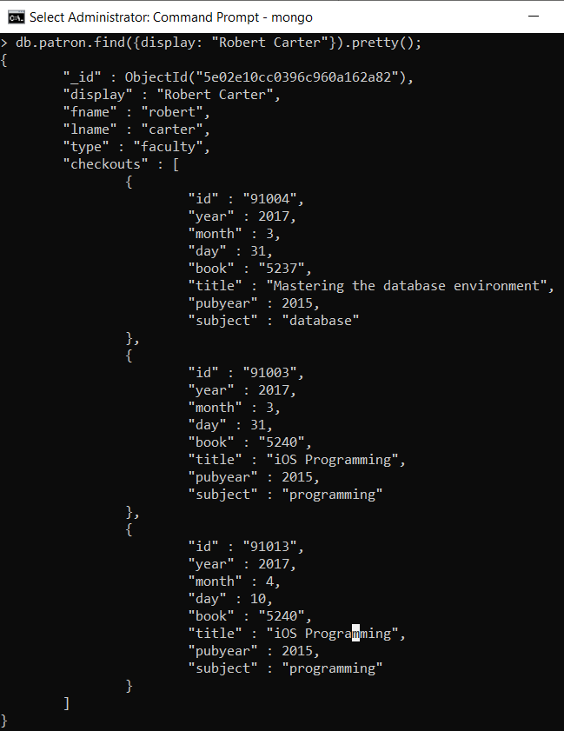
Selection and Restriction with the find() Method
To improve the readability, we can use the pretty() method.
Code: db.patron.find({display: "Robert Carter"}).pretty()
Notes:
To improve the readability, we can use .pretty() method as well.
Notice that because the projection object parameter is optional, it can be omitted when the entire document should be returned.

Slide 47
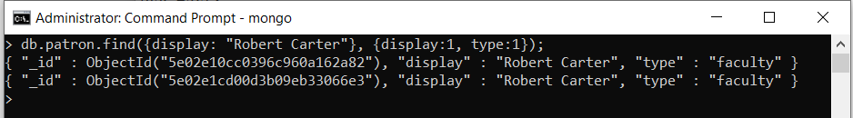
Selection and Restriction with the find() Method
The value with each key in the projection object is either 0 or 1.
The value 1 with a key indicates that the key:value pair from the document should be included in the results.
The value 0 with a key indicates that the key:value pair from the document should be omitted.
Example: retrieves the document for patron “Robert Carter” but only returns the _id, display name, and type keys
Code: db.patron.find({display: "Robert Carter"}, {display:1, type:1})
Notes:
The projection object parameter is used to specify which key:value pairs to return. The projection object contains one or more key:value pairs. The keys in the projection objects are the keys from the document to be projected. The value with each key in the projection object is either the value 0 or 1. Specifying the value 1 with a key indicates that that key:value pair from the document should be included in the results. Specifying the value 0 with a key indicates that that key:value pair from the document should be omitted.
For example, if we retrieve the document for patron “Robert Carter” but only returns the _id, display name, and type keys, we specify that display name and type keys as 1.
db.patron.find({display: "Robert Carter"}, {display:1, type:1});

Slide 48
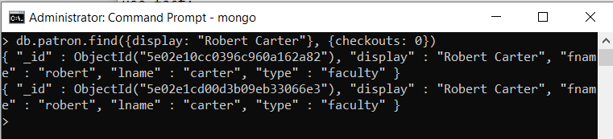
Selection and Restriction with the find() Method
To return all keys except the ones specified, use the 0 value in the projection object.
Example: returns all keys in the Robert Carter document except the checkouts
Code: db.patron.find({display: "Robert Carter"}, {checkouts: 0})
Notes:
Notice that the _id key is returned by default even when it is not specifically asked for. To return all keys except the ones specified, use the 0 value in the projection object. For example, db.patron.find({display: "Robert Carter"}, {checkouts: 0}) returns all keys in the Robert Carter document except the checkouts.

Slide 49
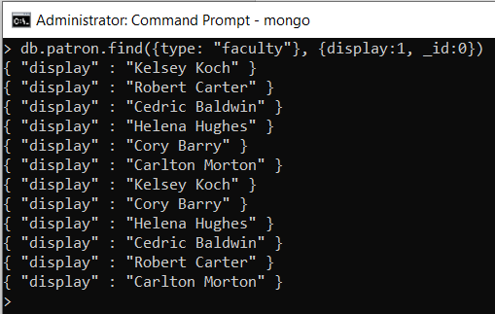
Selection and Restriction with the find() Method
When specifying keys to include, if the programmer wishes to suppress the _id key, it can be explicitly excluded.
Example: return just the display name key of all faculty patrons
Code: db.patron.find({type: "faculty"}, {display:1, _id:0})
Notes:
Generally, it is not possible to specifying including and excluding keys in the same query. The exception is the _id key that is returned by default. When specifying keys to include, if the programmer wishes to suppress the _id key, it can be explicitly excluded. For example, to return just the display name key of all faculty patrons, we can specify display as 1, and _id as 0.

Slide 50
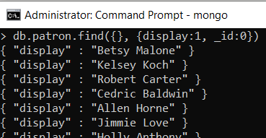
Selection and Restriction with the find() Method
If both query and projection objects are omitted, the find() method can have no parameters.
However, if query object is not needed, but the projection object is needed, we cannot omit the query object.
Solution: an empty object can be used for the query object.
Example: retrieve only the name key of every document
Code: db.patron.find({}, {display:1, _id:0})
Notes:
Recall that both the query object parameter and the projection object parameter are optional. If both are omitted, then the find() method is written with no parameters. If the query object parameter is needed, but the projection object parameter is not, then just the projection object can be omitted.
However, if the query object parameter is not needed, but the projection object is, then the programmer cannot simply omit the query object. If only one object parameter is provided, then MongoDB will assume that the one parameter is intended to be the query object parameter. In these cases, an empty object can be used for the query object similar to the way an empty object was used for updating all documents previously. For example, to retrieve only the name key of every document, we write db.patron.find({}, {display:1, _id:0});
Note that when working in the MongoDB shell, if a query returns more than 20 documents, only the first 20 are displayed on screen followed by a prompt to type “it” to display the next 20. In these cases, all documents are found and returned, but the shell is performing a simple manipulation to reduce scrolling the screen with data.

Slide 51
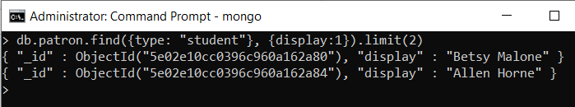
Document Pagination with limit()
Method Chaining: multiple methods are applied to the same collection
Examples: pretty(), limit(), skip(), and sort() together with find()
Limit() takes a single numeric parameter to specify the number of documents to limit to.
Example: find all documents for student patrons but limit the results to just the first two documents
Code: db.patron.find({type: "student"}, {display:1}).limit(2)
Notes:
The MongoDB shell’s behavior of displaying only a few documents at a time can be helpful, but is rather limited and might not meet the programmer’s needs. Other methods can be used with the results of the find() method to help improve the flow of documents both when viewing them interactively in the shell or when outputting them to an application.
When multiple methods are applied to the same collection, this is referred to as method chaining. Using the pretty() method with find() in an earlier example was a simple example of method chaining. Other methods can also be chained with the find() method. Among the most common are limit(), skip(), and sort().
The limit() method is used to restrict the number of documents returned. Limit() takes a single numeric parameter to specify the number of documents to limit to. Unlike the query object parameter of the find() method, limit() is not a query based on the content of the documents. After the find() method has determined which documents to return, the limit() method simply restricts the result set to the number of documents specified. For example, if we find all documents for student patrons but limit the results to just the first two documents, we write
db.patron.find({type: "student"}, {display:1}).limit(2);

Slide 52
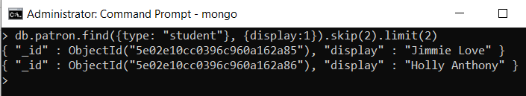
Document Pagination with skip()
The skip() function retrieves subsequent chunks of documents.
Example: retrieve two documents but skip the first two documents (i.e., show the third and fourth documents)
Code: db.patron.find({type: "student"}, {display:1}).skip(2).limit(2)
Notes:
Limit() is often used with applications that are retrieving data for display to users so that the data can be paginated into chunks by the application or website. The skip() function is also used to support pagination by allowing retrieval of subsequent chunks of documents. For example, if we are retrieving student patrons so that they can be listed for display, the previous limit() command indicates that we are using chunks of two documents at a time. To retrieve the next page of two documents, we would want to skip the first two documents because they have already been displayed and then display the next two documents. So, we write db.patron.find({type: "student"}, {display:1}).skip(2).limit(2);

Slide 53
Sorting Documents with sort()
The sort() method orders the retrieved documents based on the values of one or more keys.
If the key is associated with the value 1, the documents will be sorted on an ascending order;
If the key is associated with the value -1, the documents will be sorted on an descending order;
Multiple sort attributes → the results are sorted based on the attributes from left to right.
Notes:
Thus far, we have not concerned ourselves with the order of the documents that are returned. Due to the internal storage mechanisms used by MongoDB, documents are often returned in the order in which they were entered into the collection. However, just as with SELECT queries, we often want to control the sorted order of the data that is being returned. The sort() method allows us to do this. The sort() method of a collection orders the retrieved documents based on the values of one or more keys. Similar to the projection object parameter of the find() method, the sort() method takes an object of one or more keys paired with numeric values. In the case of projection, the values were 0 or 1.
With sorting, the values are 1 or −1. If a key is associated with the value 1 in the sort() method, then the documents will be sorted on ascending values in that key. If the key is associated with the value −1 in the sort() method, then the documents will be sorted in descending order.
Just as with the ORDER BY clause of a SQL SELECT query, when multiple sort attributes are specified, the results are sorted based on the attributes from left to right.

Slide 54
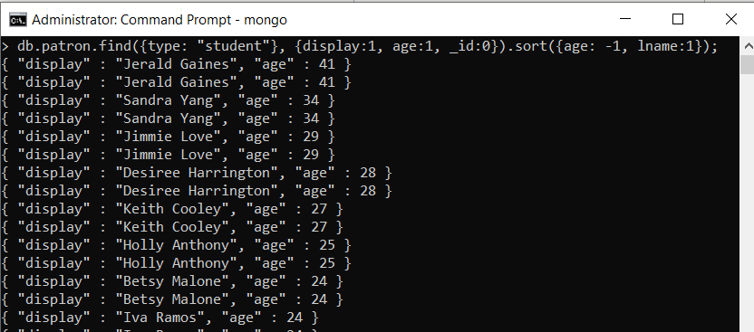
Sorting Documents with sort()
Example: retrieve the student patron documents, projects the display name and age, then sorts the results in descending order by age, and then within matching values for age the documents are sorted in ascending order by last name
Code: db.patron.find({type: "student"}, {display:1, age:1, _id:0}).sort({age: -1, lname:1})
Notes:
For example, if we retrieve the student patron documents, projects the display name and age, then sorts the results in descending order by age, and then within matching values for age the documents are sorted in ascending order by last name, we write db.patron.find({type: "student"}, {display:1, age:1, _id:0}).sort({age: -1, lname:1});

Slide 55
Orders in Chained Methods
MongoDB does not care which order the limit(), skip(), and sort() methods are chained after the find() method.
Try the following three commands:
db.patron.find({type: "student"}, {display:1, age:1, _id:0}).sort({age: -1}).limit(5).skip(5);
db.patron.find({type: "student"},{display:1, age:1, _id:0}).limit(5).skip(5).sort({age: -1});
db.patron.find({type: "student"},{display:1, age:1, _id:0}).limit(5).sort({age: -1}).skip(5);
Did you see the exact same result?
Notes:
Interestingly, MongoDB does not care which order the limit(), skip(), and sort() methods are chained after the find() method. So we can try the following three commands, which will return the exact same result.
Find, sort, limit, skip: db.patron.find({type: "student"}, {display:1, age:1, _id:0}).sort({age: -1}).limit(5).skip(5);
Find, limit, skip, sort: db.patron.find({type: "student"},{display:1, age:1, _id:0}).limit(5).skip(5).sort({age: -1});
Find, limit, sort, skip: db.patron.find({type: "student"},{display:1, age:1, _id:0}).limit(5).sort({age: -1}).skip(5);

Slide 56
Queries Using Inequalities
Use functions for inequality comparisons
The functions are used as key for a key:value pair. The value is the value that is being applied to the function.
Example: age:{$gt:20} – age > 20
age:{$lte:30} – age ≤ 30
Function | Description
$gt | Greater than “>”
$gte | Greater than or equal to “≥”
$lt | Less than “<”
$lte | Less than or equal to “≤”
$ne | Not equal “≠”
Notes:
Thus far, all queries that we’ve looked at use at most one criteria in the query object with a simple equality condition. Inequalities such as greater than, less than, and not equal to are also possible, but require the use of functions. This table lists the functions used in MongoDB for inequality comparisons.
All inequality functions operate the same way and have the same syntax. The functions are used as key for a key:value pair. The value is the value that is being applied to the function.
For example, the $gt function is used to match values that are greater than the value provided. Therefore, {$gt:20} would mean greater than 20. The function’s key:value pair is used as an object value for the key that the function is to work within. If we want to limit to documents where age > 20, then we would place the function object {$gt:20} as the value in a pair with the key age, like age:{$gt:20} in the query object parameter. Similarly, if we want to find the documents where the age ≤ 30, the criteria would be written age:{$lte:30} because $lte is the less than or equal to function, 30 is the target value for the function, and the function is being used with the age key.

Slide 57
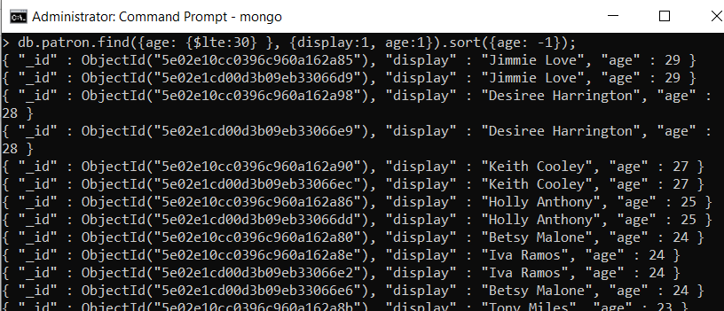
Queries Using Inequalities
Example: retrieve the display name and age from documents for patrons that are age 30 or less
db.patron.find({age: {$lte:30} }, {display:1, age:1}).sort({age: -1});
Notes:
Here is an example, to retrieve the display name and age from documents for patrons that are age 30 or less, we can write db.patron.find({age: {$lte:30} }, {display:1, age:1}).sort({age: -1});.

Slide 58
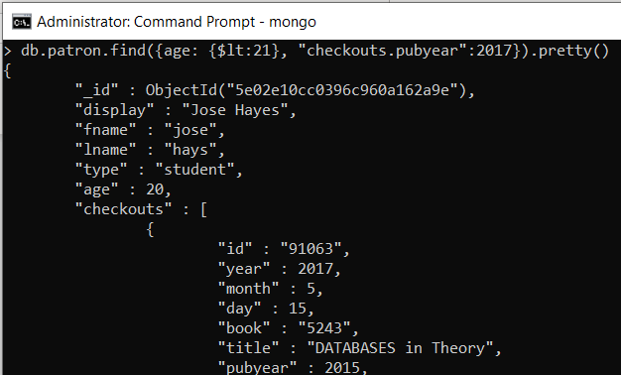
Combining Criteria: Implicit and
Implicit and: In MongoDB, the combining of multiple criteria with a logical AND connector by separating the criteria with commas.
Example: find the patrons who are under 21 years of age and have checked out a book published in 2017
Code:
db.patron.find({age: {$lt:21}, "checkouts.pubyear":2017}).pretty()
Notes:
As you would expect, MongoDB provides the ability to combine multiple criteria in the query object parameter of the find() method using logical and and or operators. Combining criteria with a logical operator can be done both implicitly and explicitly. Separating criteria with commas in the query object employs an implicit and. For example, to find the patrons who are under 21 years of age and have checked out a book published in 2017, we can write db.patron.find({age: {$lt:21}, "checkouts.pubyear":2017}). We can format the result with the pretty() method to improve readability.
Remember, the year of publication is in a subdocument so the “checkouts.pubyear” notation is required. The previous command contained two criteria: age:{$lt:21} and “checkouts.pubyear”:2017. Because these criteria are separated by a comma, MongoDB combines them with an implicit logical and.

Slide 59
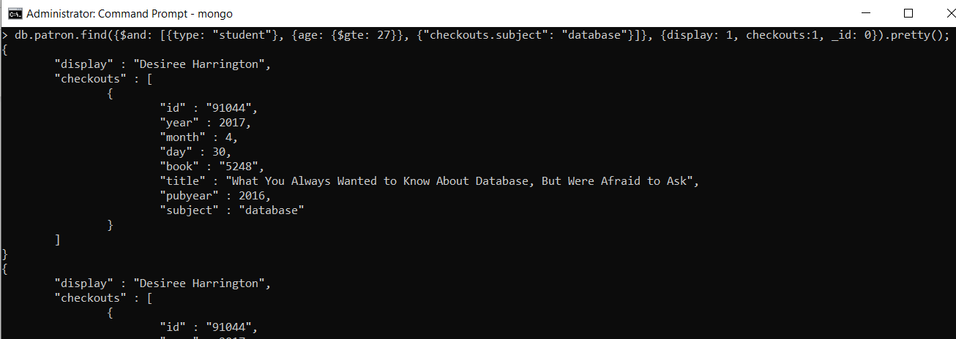
Combining Criteria: Explicit and
Explicit and: In MongoDB, the combining of multiple criteria with a logical AND connector through the use of the $and operator.
Syntax: $and: [{x}, {y}] (x and y are criteria)
Code: db.patron.find({$and: [{type: "student"}, {age: {$gte: 27}}, {"checkouts.subject": "database"}]}, {display: 1, checkouts:1, _id: 0}).pretty();
Notes:
Explicit logical and requires the use of the $and function. In practice, explicit and using the $and function tends to be preferred. With implicit and, all criteria in the list are always evaluated to true or false. With an explicit and, as soon as any criteria evaluates to false for a document, the remainder of the criteria are skipped for that document. This makes the explicit and faster and more efficient than an implicit and for most operations. The $and function appears as a key in a key:value pair that accepts an array of objects as the target value. For example, if x and y are criteria, then the syntax of $and would be $and: [{x}, {y}]. Notice that each criterion is enclosed in {} to indicate that it is an object.
To retrieve all documents that include a student over 26 years old checking out a book within the database subject, we write:
db.patron.find({$and: [{type: "student"}, {age: {$gte: 27}}, {"checkouts.subject": "database"}]}, {display: 1, checkouts:1, _id: 0}).pretty();
Again, notice that each criterion is contained inside its own set of brackets so that it is an object all to itself. The criteria objects are separated with a comma.

Slide 60
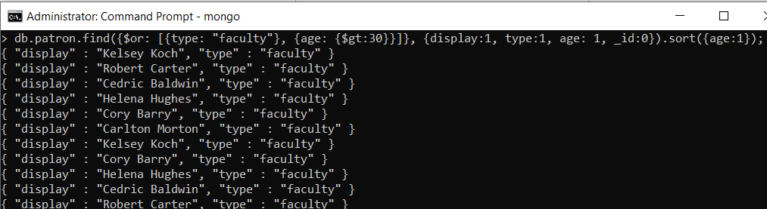
Combining Criteria: Logical or
All logical or operations are explicit.
Syntax: $or: [{x}, {y}] (x and y are criteria)
Example: retrieve documents that are for faculty or for students over 30 years of age. Only the display name, type, and age will be displayed with the results sorted by age
Code: db.patron.find({$or: [{type: "faculty"}, {age: {$gt:30}}]}, {display:1, type:1, age: 1, _id:0}).sort({age:1});
Notes:
All logical or operations are explicit. The $or function has the same syntax as the $and function. Example: retrieve documents that are for faculty or for students over 30 years of age. Only the display name, type, and age will be displayed with the results sorted by age. We can use: db.patron.find({$or: [{type: "faculty"}, {age: {$gt:30}}]}, {display:1, type:1, age: 1, _id:0}).sort({age:1}).

Slide 61
Breaking Down the Complex Query
key
query object
db.patron.find({$or: [
{type: "faculty"}, {age: {$gt:30}}
]},
{display:1, type:1, age: 1, _id:0}).sort({age:1})
value, which has two objects
projection object
Notes:
As MQL queries become more complex, they can seem confusing because of all of the punctuation. Breaking down the previous query, the symbols become a little clearer.
The query is based on the db.patron.find() method.
Within the find() method there are two objects, the query object and the projection object.
The query object is {$or: [{type: “faculty”}, {age: {$gt:30}}]}
The query object contains one key:value pair. $or is the key and [{type: “faculty”}, {age: {$gt:30}}] is the value.
The value for the $or key is an array composed of two objects. The first object is {type: “faculty”}, and the second object is {age: {$gt:30}}.
The first object in the array is a simple key:value pair, that is, type: “faculty.”
The second object in the array is a key:value pair with age as the key and an object for the value. The object value is {$gt:30}, which calls the greater than function with 30 as the target value of the function.
The projection object is is {display:1, type:1, age:1, _id:0}. It contains a list of key:value pairs.
The keys in the object associated with value 1 are included in the result. The key in the object associated with the value 0 is excluded from the result.
The sort() method is chained to the find() method to specify a sorted order for the output. It contains an object made of simple key:value pairs.
The keys in the sort object associated with the value 1 are sorted in ascending order. If any key has been associated with the value −1, it would have been sorted in descending order.

Slide 62
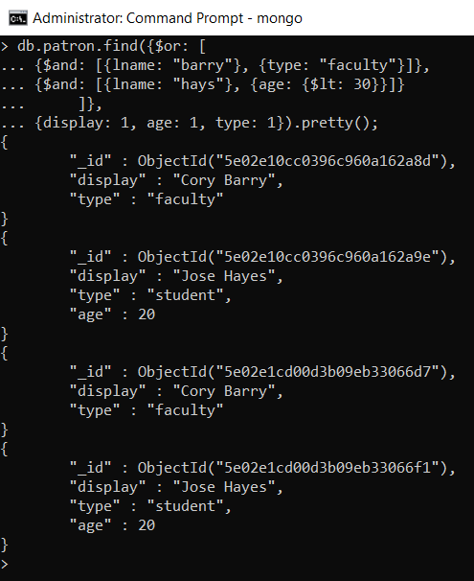
Combining Criteria: Mix $and and $or
Example: retrieve the _id, display name, and age for patrons that either have the last name “barry” and are faculty, or have the last name “hays” and are under 30 years old
Code:
db.patron.find({$or: [
{$and: [{lname: "barry"}, {type: "faculty"}]},
{$and: [{lname: "hays"}, {age: {$lt: 30}}]}
]},
{display: 1, age: 1, type: 1}).pretty();
Notes:
The $and and $or functions can be mixed within the same query object. For example, to retrieve the _id, display name, and age for patrons that either have the last name “barry” and are faculty, or have the last name “hays” and are under 30 years old, we write
db.patron.find({$or: [
{$and: [{lname: "barry"}, {type: "faculty"}]},
{$and: [{lname: "hays"}, {age: {$lt: 30}}]}
]},
{display: 1, age: 1, type: 1}).pretty();

Slide 63
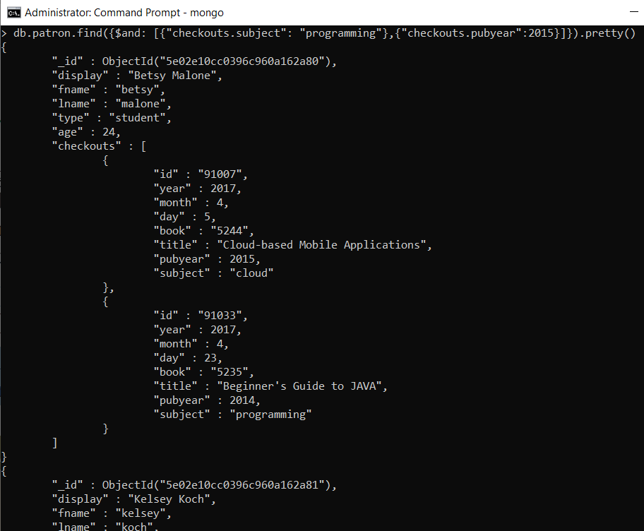
Matching Elements in Arrays with $elemMatch
Question: find the patrons who have checked out a book in the programming subject that was published in 2015
A few patrons who checked out a book that was published in 2015 and who checked out a book on programming, but they were not the same book!
Our intention was that the same book satisfies both criteria, not two separate books each satisfying one criteria apiece.
Notes:
As with performing updates, working with arrays can pose unique challenges when writing queries. Consider the following requirement: find the patrons who have checked out a book in the programming subject that was published in 2015. Based on our coverage of $and and using dot notation with subdocuments, we can craft a query: db.patron.find({$and: [{"checkouts.subject": "programming"},{"checkouts.pubyear":2015}]}).pretty().
The results include documents that have checkouts of books in the programming subject, and books published in 2015, so both criteria are met. However, looking through the output we find a few patrons who checked out a book that was published in 2015 and who checked out a book on programming, but they were not the same book! Our intention was that the same book satisfies both criteria, not two separate books each satisfying one criteria apiece.

Slide 64
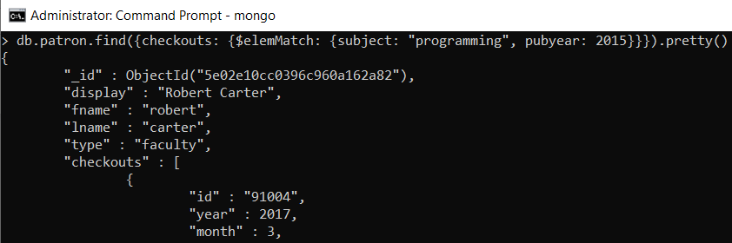
Matching Elements in Arrays with $elemMatch
The $elemMatch function requires that all criteria included in the function be satisfied by the same element in an array.
Example: find the patrons who have checked out a book in the programming subject that was published in 2015
Code: db.patron.find({checkouts: {$elemMatch: {subject: "programming", pubyear: 2015}}}).pretty()
Notes:
This problem is solved with the $elemMatch function. In mathematical terminology, items in a set are called elements. It is, therefore, appropriate to refer to the values in an array as elements. The $elemMatch function accepts an object containing a list of criteria as a parameter. The $elemMatch function requires that all criteria included in the function be satisfied by the same element in an array. In the current database, the elements in the checkouts array are objects that represent each checkout by a patron. Using $elemMatch with the criteria in the previous command requires both criteria to be satisfied by the same checkout. So, we can write db.patron.find({checkouts: {$elemMatch: {subject: "programming", pubyear: 2015}}}).pretty();

Slide 65
Summary
MongoDB is a document database that stores documents in JSON format. The documents can be created, updated, deleted, and queried using a JavaScript-like language, named MongoDB Query Language.
Documents of a similar nature are stored together in a collection. Even though the documents are similar, they are not required to have exactly the same structures. A document database may contain many collections.
Documents can be updated by either a replacement update or an operator update. A replacement update will replace an entire document with a new document that has the same unique id. An operator update can be used to modify specific key:value pairs in a document without impacting the remainder of the document.
Data retrieval is done primarily through the find() method. Within the find() method, functions can be used to write complex logical criteria.
Other methods can be chained to the find() method to support pagination, restricting results, and formatting output.
Notes:
MongoDB is a powerful document database that is being adopted by many organizations. It was originally designed to support web-based operations, and as such, it draws heavily on JavaScript for the structure of its documents and for MQL. In this course, we have learned about the basic create, read, update, and delete operations that are central to database processing. This should give you a basic familiarity with MongoDB and MQL, but there is much more to learn if you are interested in pursuing a career in document databases.

Slide 66
Review Questions
What is the difference between a replacement update and an operator update in MongoDB?
Explain what an upsert does.
Describe the difference between using $push and $addToSet in MongoDB.
Explain the functions used to enable pagination of results in MongoDB.
Explain the difference in processing when using an explicit and and an implicit and with MongoDB.
Notes:
1. What is the difference between a replacement update and an operator update in MongoDB?
In MongoDB a replacement update will replace the entire document being updated. If the existing document has key:value pairs that are not included in the update command, then those pairs are lost. Only the pairs specified in the update command will exist in the replaced version of the document. With an operator update, the existing document is unchanged except for the changes specified in the update command. Pairs not included in the update command are not affected.
2. Explain what an upsert does.
Upsert is a combination insert / update. If an existing document is found that matches the criteria given, then an update is performed on that document using the key:value pairs specified in the command. If an existing document is not found that matches the criteria given, then an insert is performed to create a document with the key:value pairs specified in the command.
3. Describe the difference between using $push and $addToSet in MongoDB.
Both commands are used to add a value to an array. The $push command will always add the value to the array, even it results in duplicate values in the array. The $addToSet command will only add the value to the array if adding it does not result in duplicate values in the array.
4. Explain the functions used to enable pagination of results in MongoDB.
Results can be provided in pages of information by using limit() and skip() functions. The limit() function specifies how many results to return. The skip() function allows the programmer to provide an offset of documents before the limit is applied.
5. Explain the difference in processing when using an explicit and and an implicit and with MongoDB.
With both forms of logical and the DBMS must apply criteria to a document to determine if the document should be included in the results. An explicit and, using the $and operator, will determine that a document should not be included and stop applying criteria to that document as soon as one of the criteria evaluates to FALSE for that document. An implicit and will apply all criteria to the document before determining if the document should be included or not in the results. As a result, explicit and tends to perform better in most cases.

